Slide 1
Banner 8 vs Banner 9
Differences

Slide 2
General Differences (Baseline Pages)

Slide 3
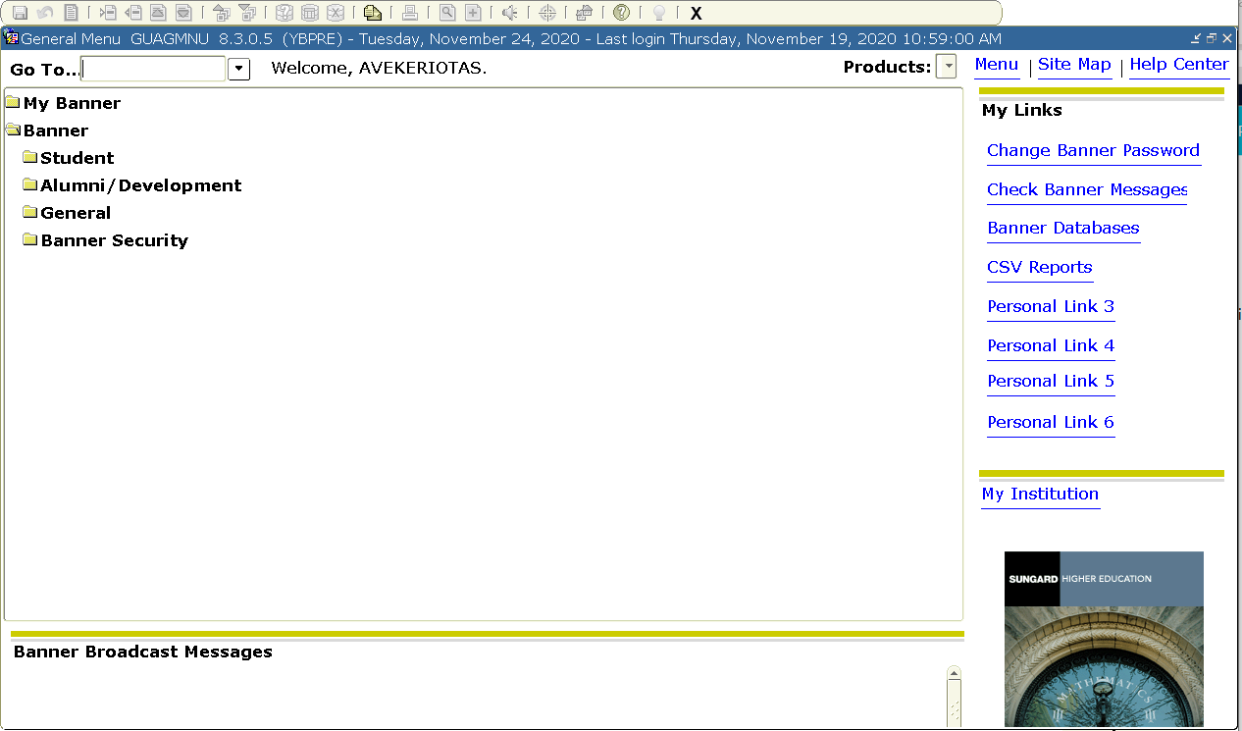
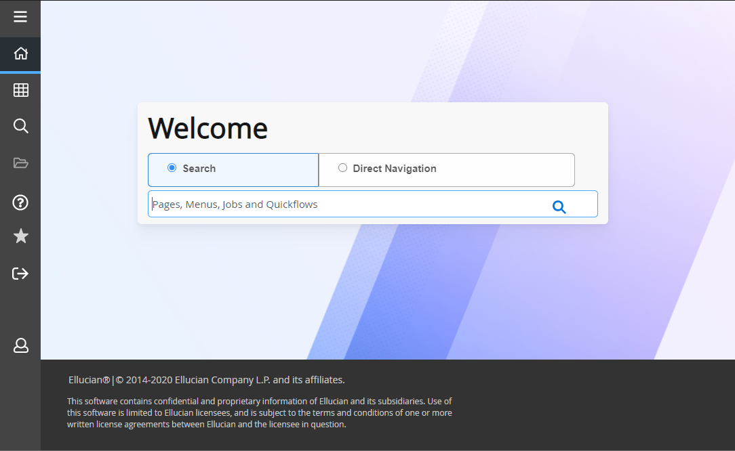
General Differences -
General Menu > Landing Page
Banner 8: After logging in, you will be taken to the General Menu.
Banner 9: You will now be taken to the
Landing Page/Application Navigator.

Slide 4
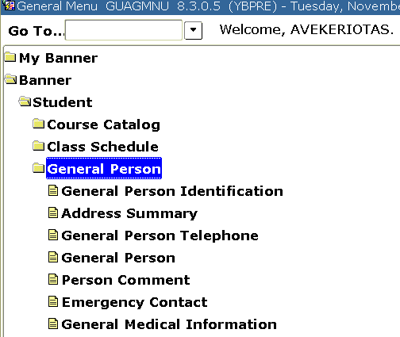
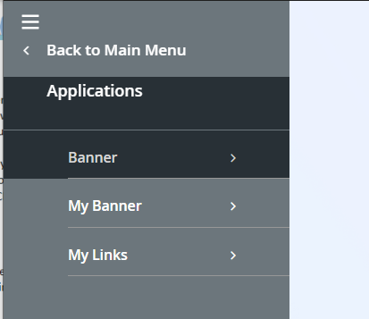
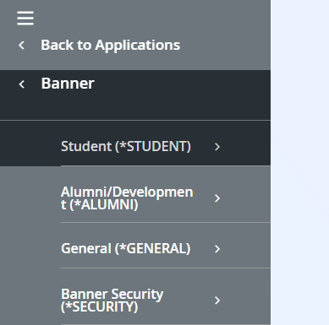
General Differences -
Menu Navigation > Applications
Ctrl +M
Menu Navigation
Menu Navigation is now just a part of the Landing Page menu under Applications.
To access Applications: Press CTRL+M or click the icon shown by the red arrow.
Applications will include:
Self Service Banner
Administrative Banner pages

Slide 5
General Differences -
Navigation To Form > Search For Page
Banner 8: To access a form users had to type the 7- character name in the “Go-To” box.
Banner 9: Users will type either a 7-character code or some of the description to receive a list of possible matches into the search box on the Landing Page.
After typing in 7-character name, users can just hit enter, or they can select a page from the list returned.
Beware of the auto-complete feature. It can sometimes auto-complete a form as you type and take you to a completely different form than you intended to go to.

Slide 6
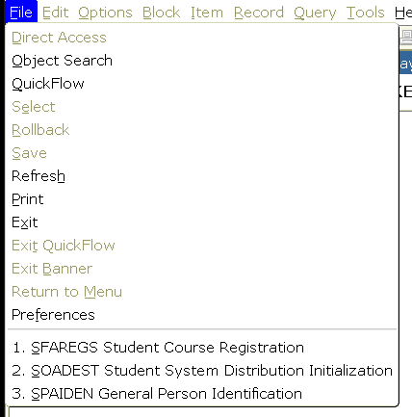
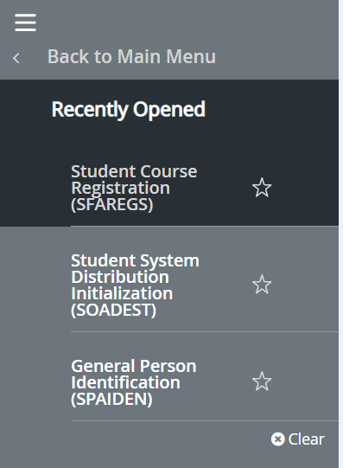
General Differences -
Recent Forms > Recently Opened Pages
Ctrl +Y
Recently Opened
Recent Forms
Recent Forms will now be found in the ‘Recently Opened’ tab shown by the red arrow.
It can be accessed by clicking on the icon or by pressing CTRL+Y on your keyboard.
It will list all pages that you’ve accessed in that particular session.

Slide 7
General Differences -
Close Form > Close Page
Ctrl +Q
Close Form button is now called Close Page button.
The button has now moved from top right of the user interface to top left.
CTRL + Q shortcut has not changed, when pressed it’ll close the page and return you to the Landing Page.

Slide 8
General Differences -
Close/Logout of Banner > Sign Out of Application Navigation
Ctrl +Q
Ctrl + Shift + F
Banner 8: To logout users would keep clicking the black X or pressing CTRL+Q.
Banner 9: Users will have to sign out through Landing Page/Application Navigation by clicking the icon shown by the red arrow or pressing CTRL + SHIFT + F on the keyboard.

Slide 9
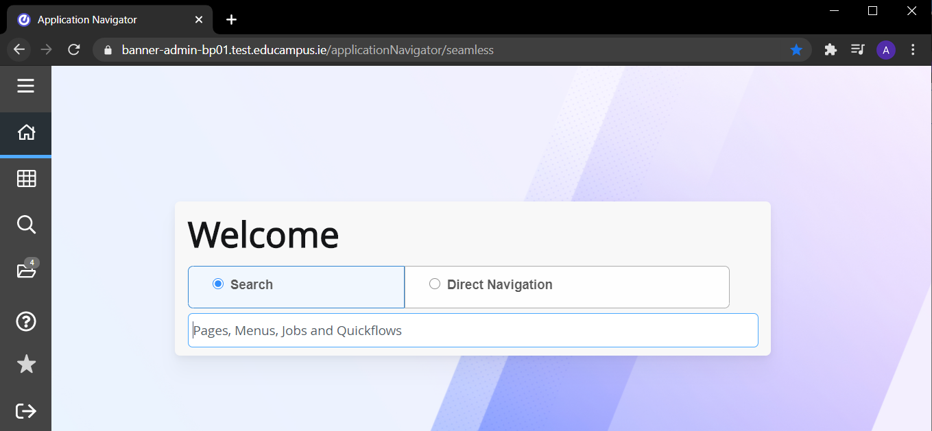
General Differences -
Logout of Multiple Sessions > Sign Out of Last Window
Ctrl +Q
Banner 8: Users had to sign out of each session when they had multiple windows open so the session wouldn’t hang and potentially cause issues with the user session count.
Banner 9: If you sign out of one session, it will sign you out of all of them. To close down a window that’s not needed, simply close the window by clicking the highlighted X.
Ctrl + Shift + F

Slide 10
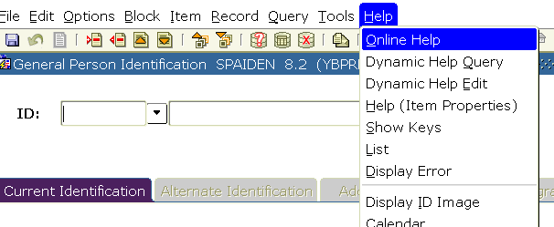
General Differences -
Form Online Help > Page Help
Ctrl + Shift + L
To access help…
Banner 8: On the top of a form a user had to click Help -> Online Help.
Banner 9: It is now in the Main Menu Bar on the side of the page as shown in the picture. It is only available once you’re in an actual page, this feature is not available from the Landing Page.

Slide 11
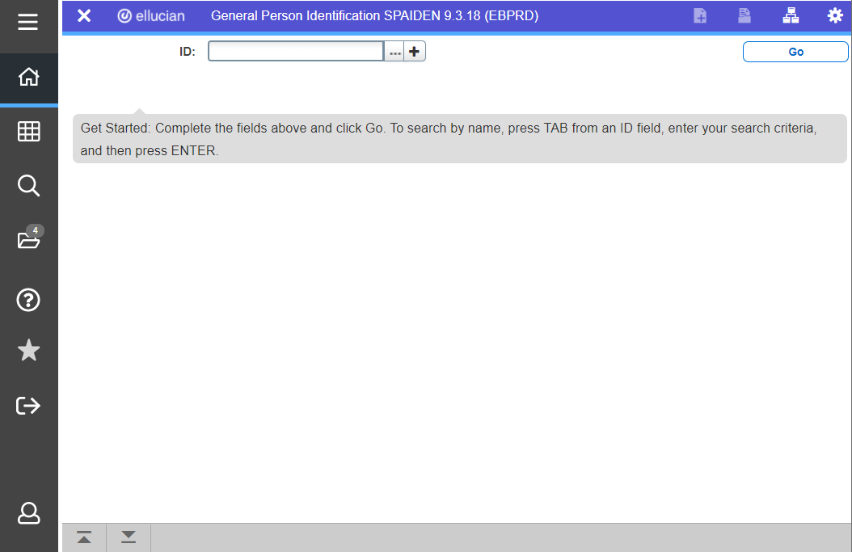
General Differences -
Next Block > Go
CTRL + PageDown
Banner 8: Next Block is located above the form. Keyboard shortcut; CTRL+Page Down.
Banner 9: Next Block is now the ‘Go’ button. Can also go up/down blocks by pressing arrow buttons located on the bottom left of the page. Keyboard shortcut now; ALT+PageDown. (Should still be able to do the shortcut with just one hand)
ALT + PageDown

Slide 12
General Differences -
Rollback > Start Over (refresh)
Shift + F7
F5
Banner 8: Roll back is a green arrow located on top left of the form. Keyboard shortcut; Shift + F7.
Banner 9: Roll Back will now be called Start Over. The button will now be located on the top right of the page. Keyboard shortcut is now; F5.

Slide 13
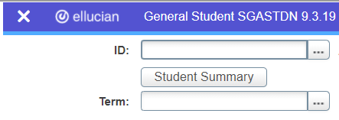
General Differences -
Person ID Look Up: Drop Down > Ellipses
Banner 8: To look up a student ID users need to click the drop-down arrow.
Banner 9: Drop-down arrow is replaced with Ellipses(…)
Users can still use F9 to access SOAIDEN.

Slide 14
General Differences -
Name Quick Search
Banner 8: If users didn’t enter an ID number and tabbed to the name field, they could type in the individuals name (lastname,firstname) and find the person that way.
Banner 9: Name field is not there when navigating to the page, but it is still possible to tab into it and use the old method to search by name.

Slide 15
General Differences -
Key Block: Static > Collapsed & Variable
Banner 8: The key block layout was static.
Banner 9: the key block will be expanded for initial entry
Then collapse to a different display when you go down to access the data.
The collapsed layout will depend on the width of your window. Data will move around if you resize the window.

Slide 16
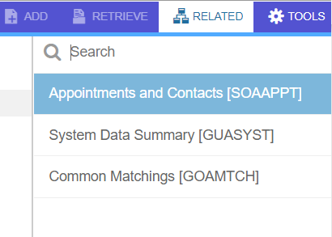
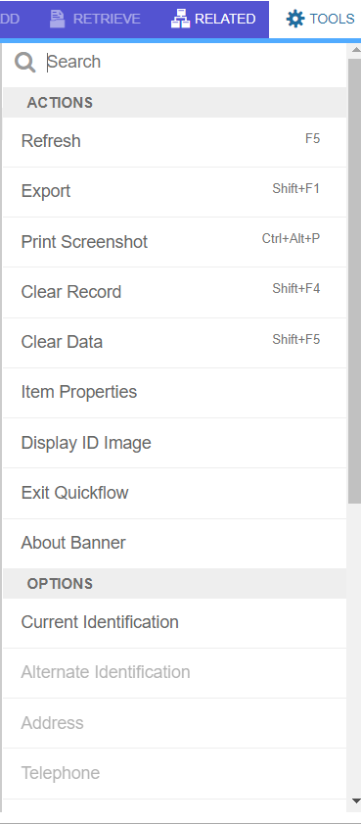
General Differences -
Options Menu > Related & Tools Menu
Options Menu is now split into Related and Tools menus.
If the Option was for the particular form (tab navigation or taking action on that data) it has been moved to the Tools menu.
If the Option was to go to another form, it has been moved to Related menu.
You will find Related and Tools menus located on the top right corner on the user interface.

Slide 17
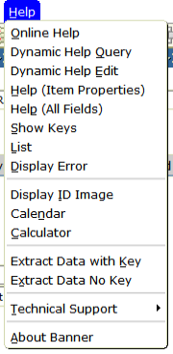
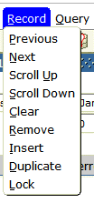
General Differences -
Item, Record, Tools & Help Menus > Tools Menu
Most of the other items available under Item, Record and Help menus also moved to the Tools Menu.

Slide 18
General Differences -
Extract Data > Export
Banner 8: To extract data, users would click Help
-> Extract Data with/No Key.
Banner 9: Users will now click Tools -> Export.
Export is only available if it has been turned on for that particular page.
If the Export functionality is not working but it would be helpful to have, please log it with us and we can work with Ellucian to determine if it can function for that particular page.

Slide 19
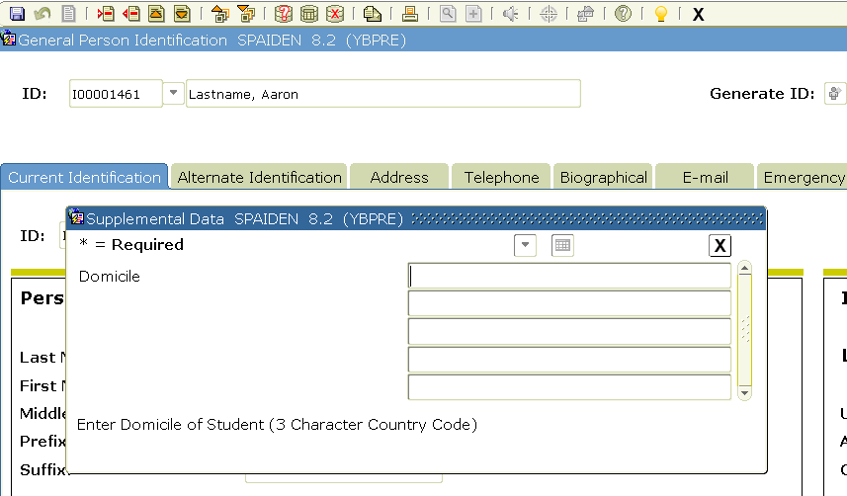
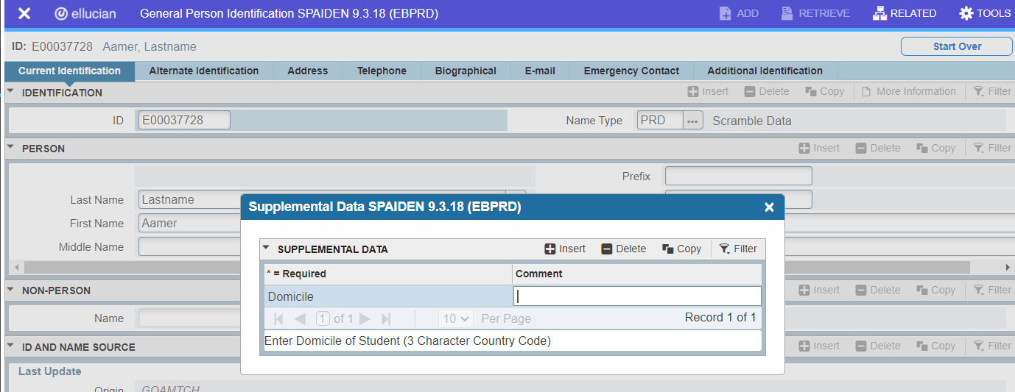
General Differences -
SDE Fields: Lightbulb > More Information
Banner 8: SDE fields used to be available on pages where the lightbulb was yellow. If there were no SDE fields, the lightbulb was greyed out. Lightbulb would be shining when there was data in SDE fields
Banner 9: Lightbulb replaced with ‘More Information’ label with a document icon. It will appear when SDE fields exist on a page. Document icon will be filled in when there is data in SDE fields.

Slide 20
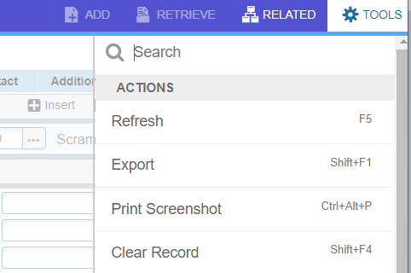
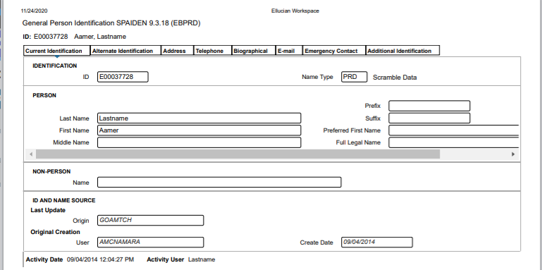
General Differences -
Banner Print Screen > Print Page
SHIFT + F8
CTRL + Alt + P or CTRL + P
Banner 8: Users had the ability to print exactly what was on the screen. Print by pressing print icon or SHIFT + F8.
Banner 9: See image on the right for an example of Banner 9 print. Print by pressing Tools -> Print Screenshot or by pressing CTRL +ALT + P. (Also Tools -> Print or CTRL + P)

Slide 21
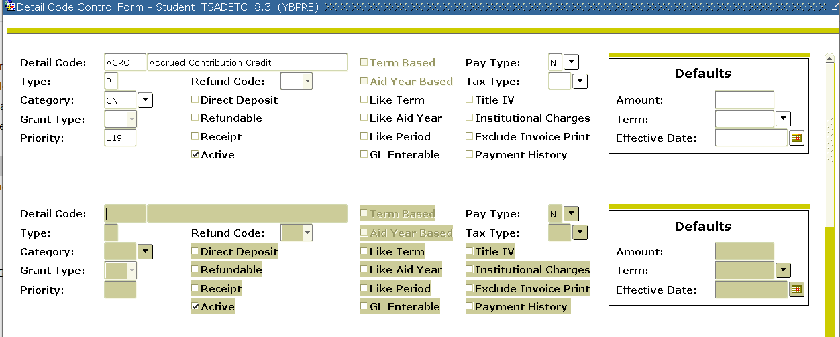
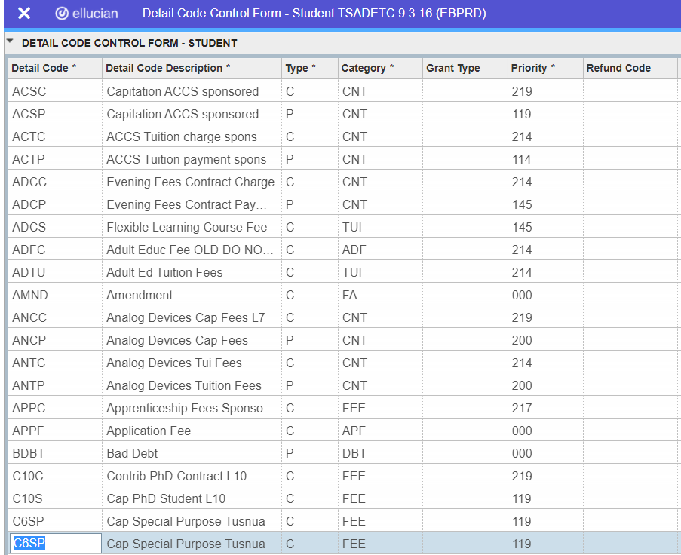
General Differences -
Insert Record/Copy Above > Copy Record
Banner 8: To copy a record, users had to insert a new(blank) record, and then copy the record above. This was done by pressing F6 then F4 on the keyboard.
Banner 9: To copy a record make sure you are on the record you want to copy. Then just copy (F4) to create a new record below or after the original one.

Slide 22
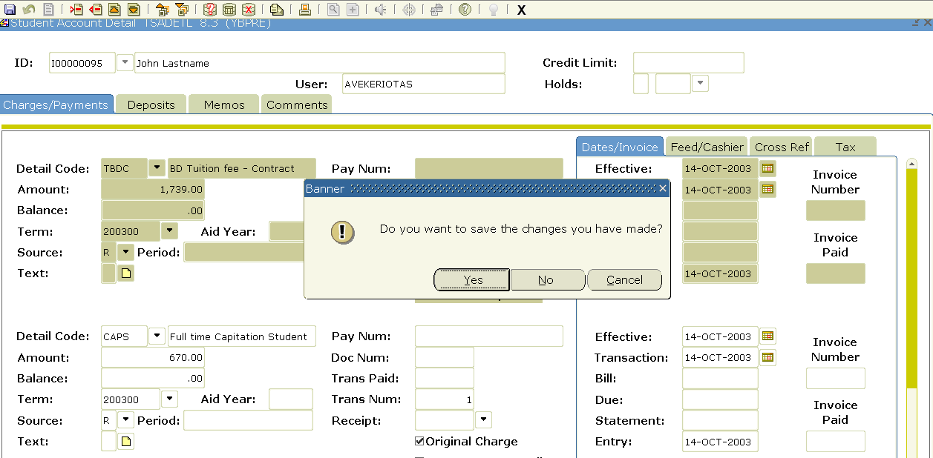
General Differences -
Warnings/Errors/Successes > Message Center
Message Center –
Click to see messages.
Banner 8: Messages were displayed in a combination of pop-up windows, message bars.
Banner 9: All messages (warnings, errors, success) will now be located at the message center on the top right of page.
A number will appear once there are messages to view.
By clicking on the number you can toggle the messages on/off.
Messages are colour coded; Red = errors, Yellow = Warnings, Green = Success.
Some messages will require acknowledgement, such as: Clicking “Okay” within the message.

Slide 23
General Differences -
Activity Date & Username
The username and activity date associated with a record has now moved from the body of the page down to an informational bar at the bottom of the page.
This means that you will not find ‘Activity Date’ column on pages(forms) anymore.
‘ID and Name Source’ tab will not contain User/Activity Date as that is moved to the bottom, but the ‘Origin’ will still be found within the page.
Data will be displayed for whichever record is selected on the page.

Slide 24
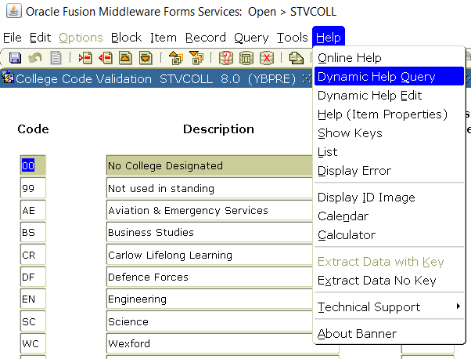
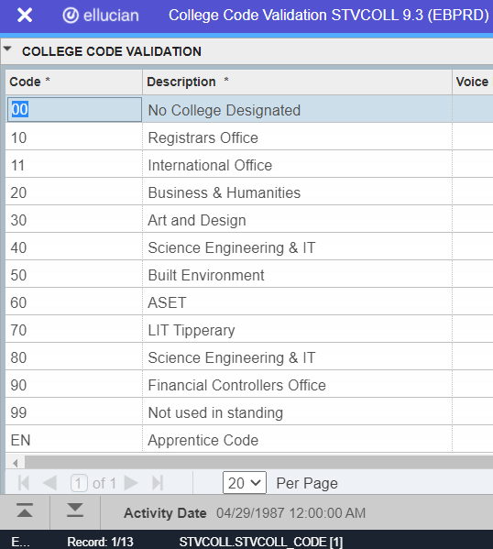
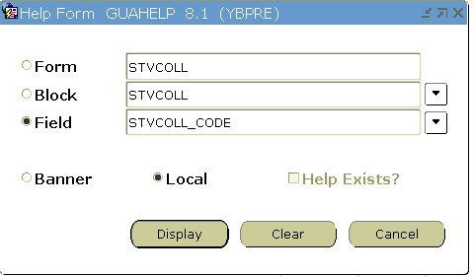
General Differences -
Table/Column Name
Banner 8: In order to find out a table/column name, users needed to click Help ->Dynamic Help Query.
Banner 9: Table/column name is now displayed in an informational bar at the bottom. (Please note the window may need to be fully expanded to display this)

Slide 25
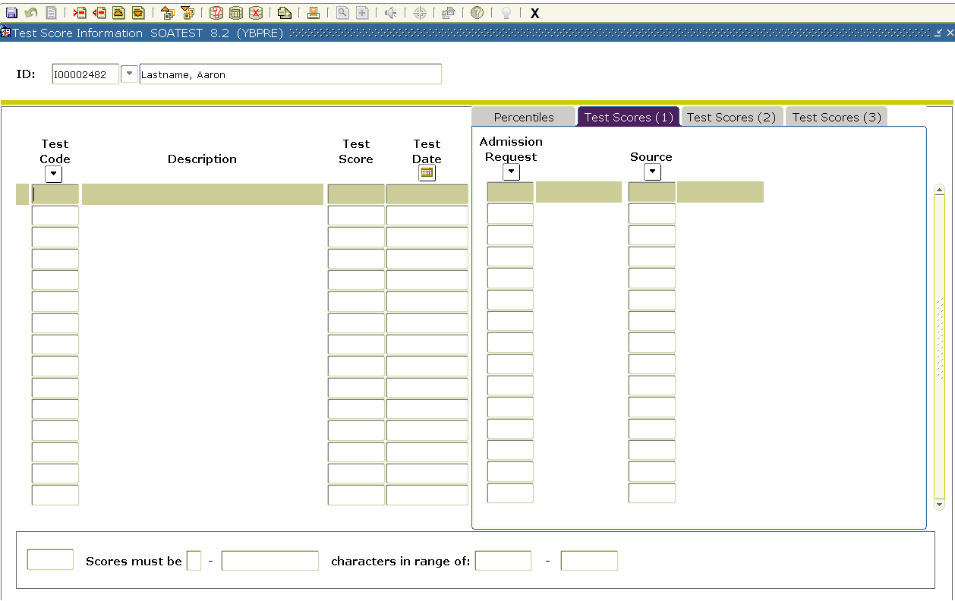
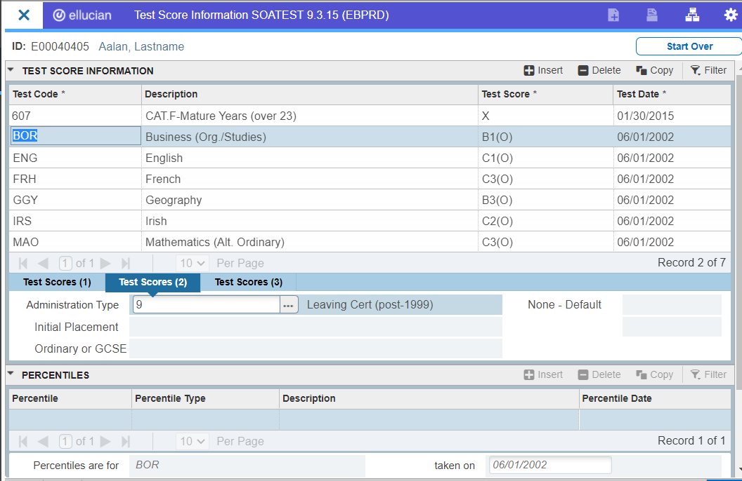
General Differences -
Table/Column Name
There may be some visual changes on some pages(forms) on the new user interface.
Example above - The data that used to be linear for each record, some split across tabs, may now be split into separate sections of the form. Moving from one record to the next will be mirrored in the other sections.

Slide 26
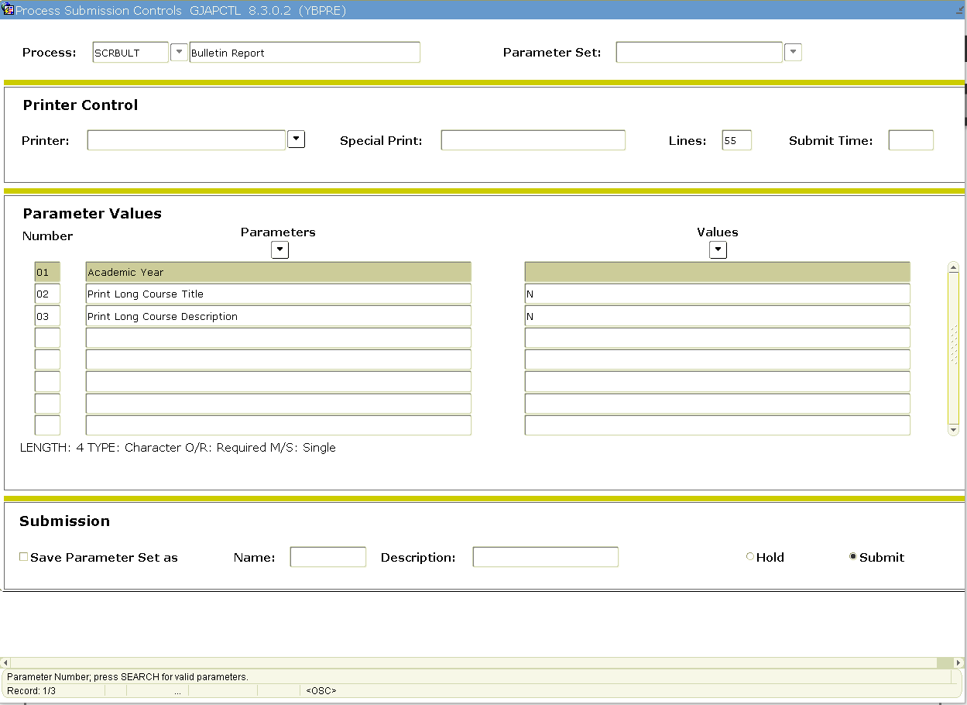
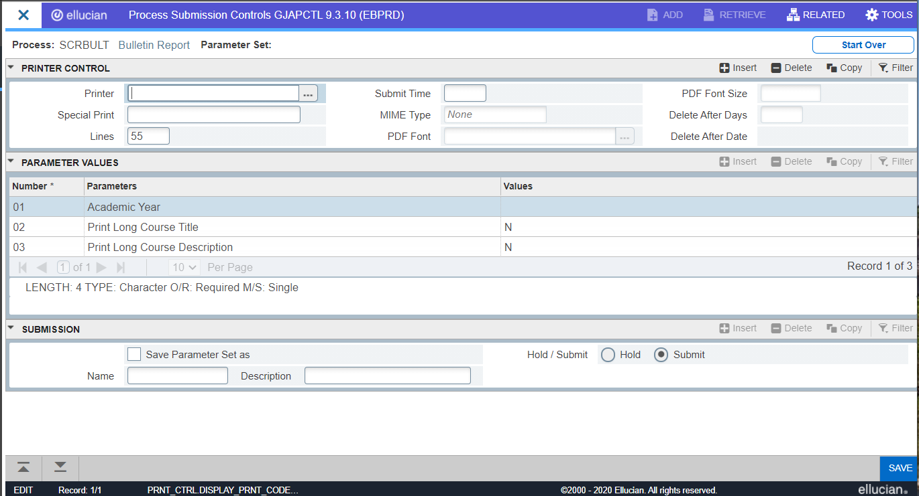
General Differences -
Process Submission Control
Not much has changed for running reports/processes from job sub, except extra fields have been added to Printer Control section.
Sequence number is now located in the message centre rather than the bottom message bar.

Slide 27
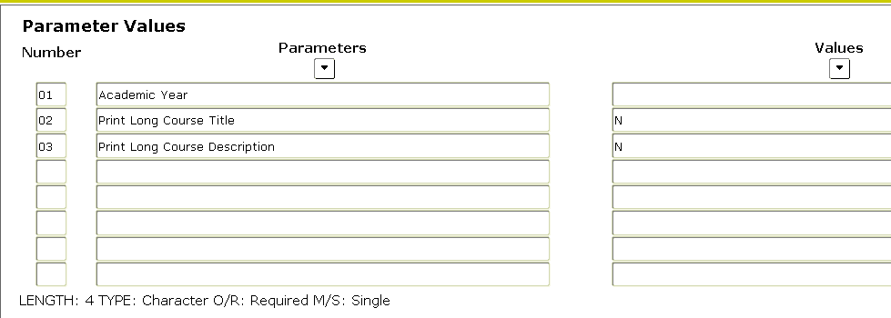
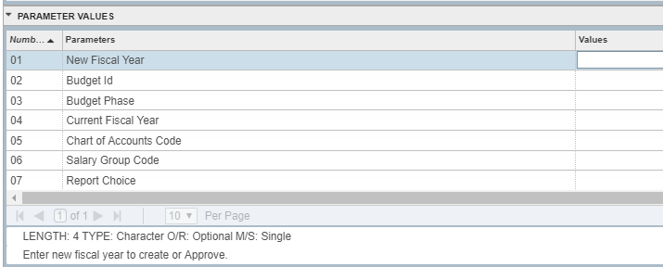
General Differences -
Process Submission Control
Banner 8: To pull up a list of valid entries for a parameter users had to click drop-down arrow.
Banner 9: The drop-down arrow is now changed to ‘…’ and located on the same row as the parameter.
Parameter help text is in the same area.

Slide 28
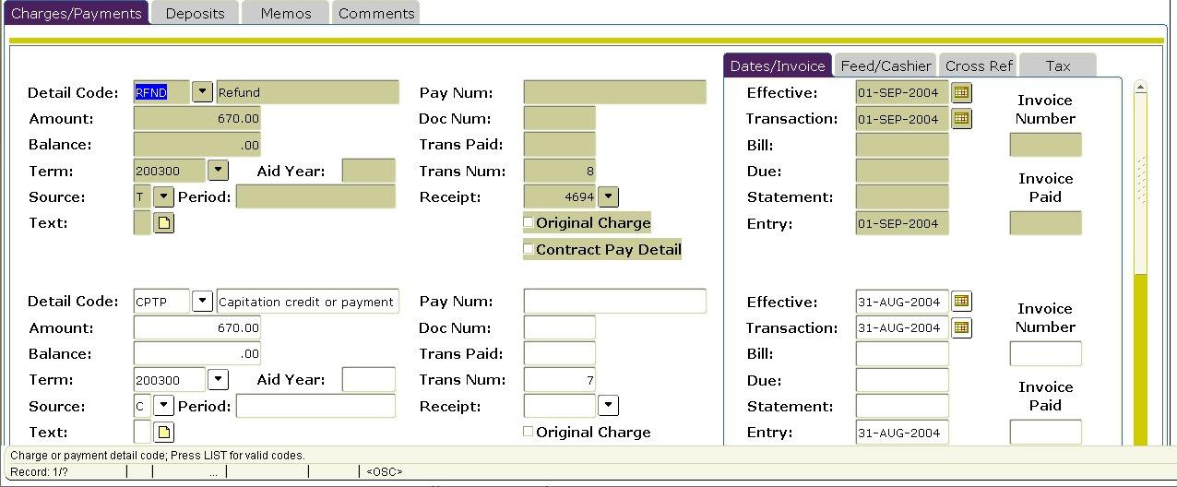
General Differences -
Query in Form > Filter: Basic & Advanced
Banner 8: Users were inputting queries directly into the fields available on the form. Searching was limited to positives. (Couldn’t say you wanted records with a field blank, numbers greater than a certain amount, etc.)
Users could click F7, type in the field they want to query on, then F8.

Slide 29
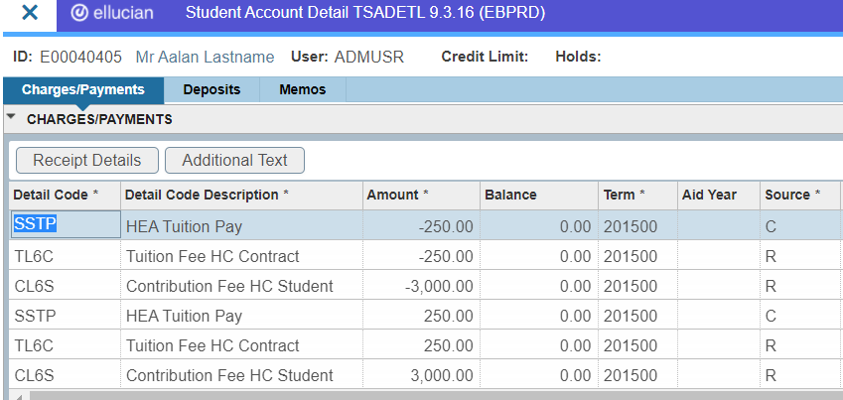
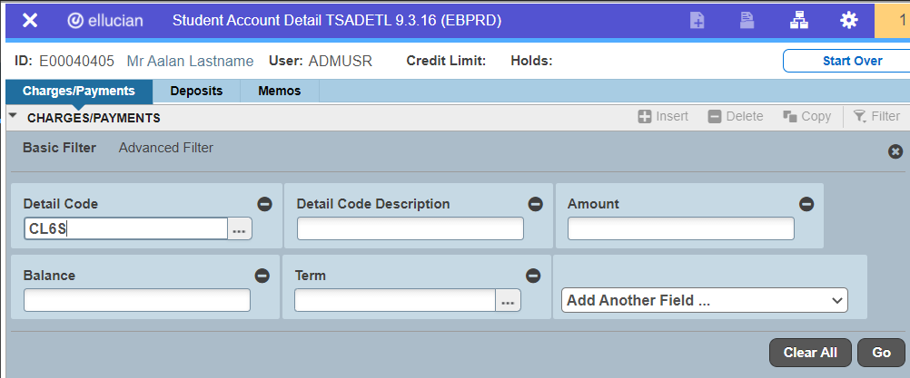
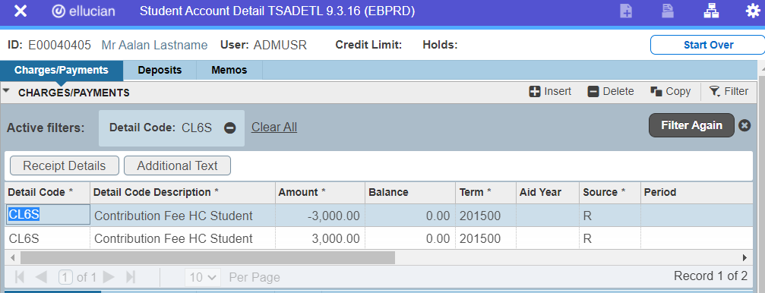
General Differences -
Query in Form > Filter: Basic & Advanced
Banner 9: Filtering opens up fields to input your search parameters. Basic Filter allows for the same sort of search capabilities as were present in Banner 8.
Click on Filter(F7), type data in the field you want to query on, then click Go(F8)

Slide 30
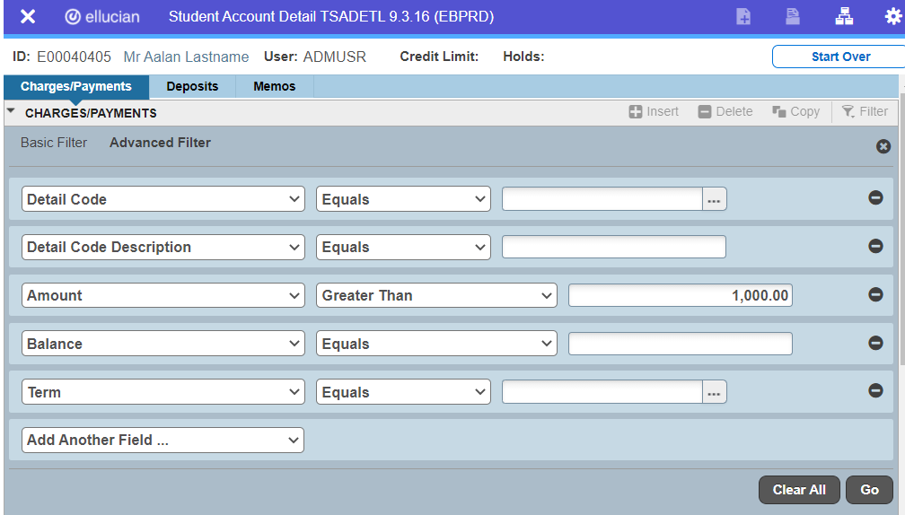
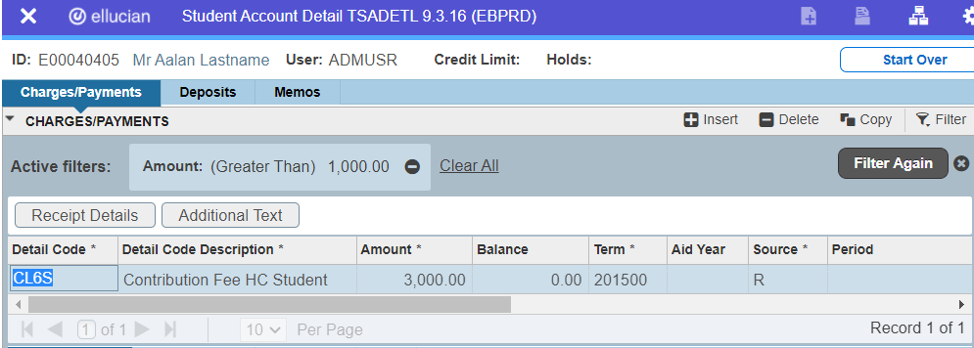
General Differences -
Query in Form > Filter: Basic & Advanced
Banner 9: Has an Advanced Filter. You can toggle this filter to use more robust comparison operators like “Is NULL”, greater than, etc.
Click on Filter(F7), select comparison operator and type data into the fields you want to query, then click Go(F8)

Slide 31
General Differences -
Query in Form > Filter: Basic & Advanced
Basic Filter defaults to first 5 fields displayed on the page.
Fields can be removed or added.
Advanced Filter also defaults to first 5 fields.
Fields can be removed or added.
More options for comparison (e.g. contains, starts with, is NULL, etc.)

Slide 32
General Differences (Custom Pages) i.e. pages with second character ‘Z’ e.g. SZAPATT

Slide 33
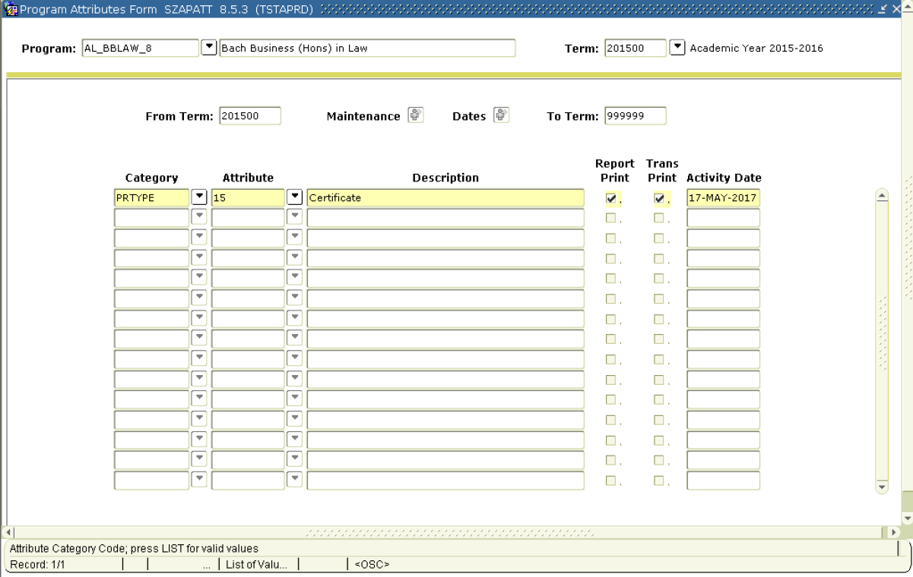
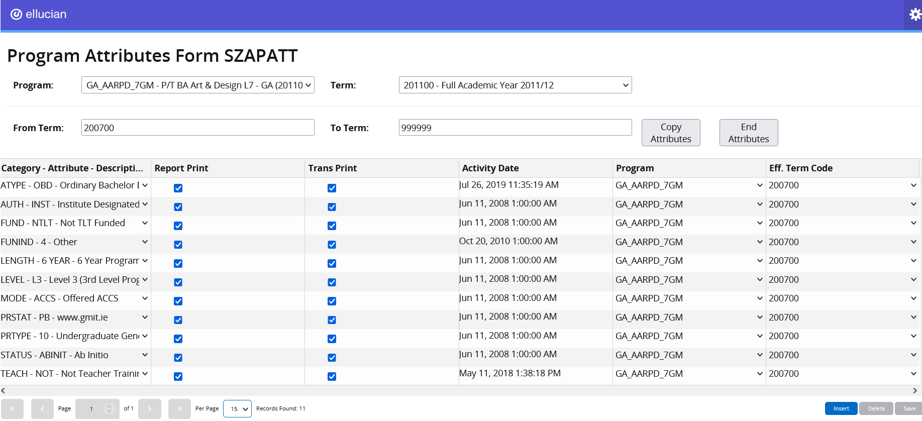
General Differences (Custom) -
New Look
Banner 8 – custom pages were developed as Oracle Forms, hence they looked like baseline Banner pages.
Banner 9 – these pages have been developed using Page Builder functionality. As a result, the pages will look and work differently than baseline Banner pages.

Slide 34
General Differences (Custom) -
Key Block
Banner 9 – all of the available values will be presented to the user using drop-down lists.
The values displayed are taken from the relevant database tables.
Please Note: It’s not possible to key in a value or to search/filter through the list of values.

Slide 35
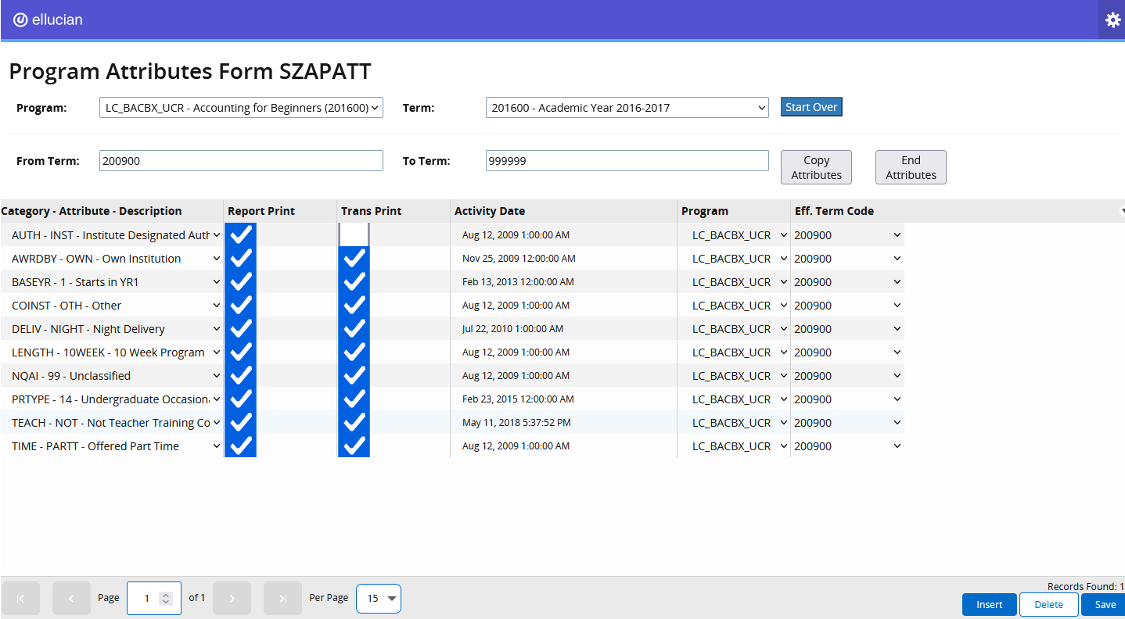
General Differences (Custom) -
Insert/Delete/Save
Banner 9 – To Insert, Delete or Save records, users will need to use the buttons highlighted in red.
Please Note: F10 shortcut to save a record does not work on custom pages.

Slide 36
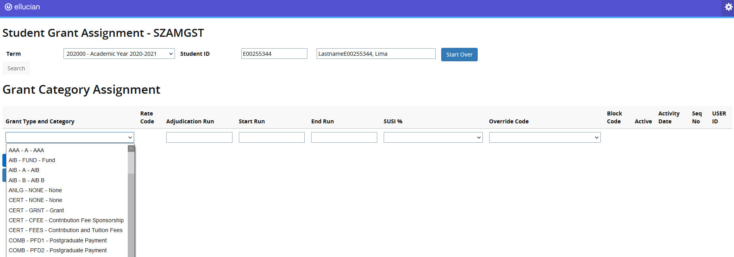
General Differences (Custom) -
Populating a field
Banner 9 – To populate fields, users will have to either select the relevant values from drop-down lists, key in values or select values from a calendar.
Please Note: Some of the columns that were separate in Banner 8 are now concatenated as shown in the first column.

Slide 37
General Differences (Custom) -
Close a Page (form)
Banner 8 – To close a custom page, users would click the ‘X’ button/icon.
Banner 9 – To close a custom page, users will now have two options. Click on:
Your logo on the page OR
Home icon on the menu to the left of the page.
Please Note: This brings you to the Home page of Application Navigator. The page will continue to be open in the background.

Slide 38
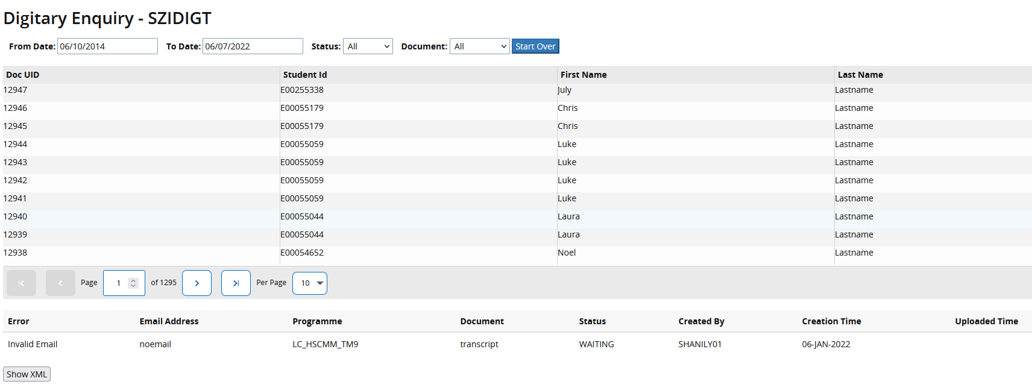
General Differences (Custom) -
SZIDIGT – Viewing Errors
Banner 8 – Any errors encountered were displayed on the same row as Doc UID Student ID, First Name, Last Name of a student.
Banner 9 – To see if there is an error associated with a student, users must click on a student’s record.
The error, email address, programme, document, status fields will appear on the bottom of the page. (Please make sure that the “Per Page” setting is set to below 50)

Slide 39
New to Navigation

Slide 40
New to Navigation -
Multiple Records Display
Use arrows to move forward or backward through pages
Change the number of records displayed on the page
See which record you’re on and how many total records have been returned
Use jump arrows to move forward to last page or backward to first page, can also type in page number and tab to jump to that page.

Slide 41
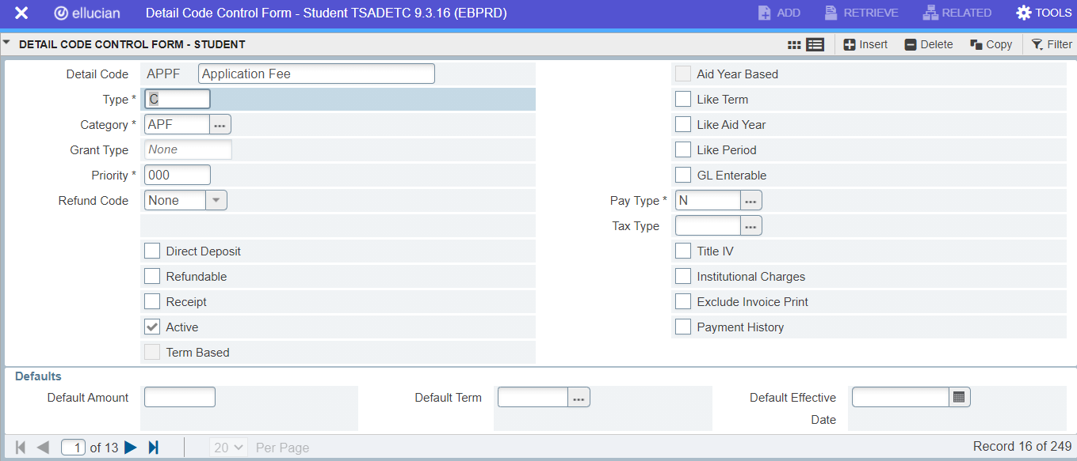
New to Navigation -
Multiple to Single Record Toggle
Use to toggle (Ctrl +G) between multiple and single records**
**Some new pages allow you to toggle between multiple records arranged in a linear fashion and individual records displaying in the “page” layout.

Slide 42
New to Navigation -
Single Record Display
In some forms, when data isn’t displayed in a linear fashion, one record per page will be displayed and pages can be used to navigate between those records.
Use pagination to move between multiple phone numbers
Notes:
Change screenshot in Banner 9. Find a form for this.

Slide 43
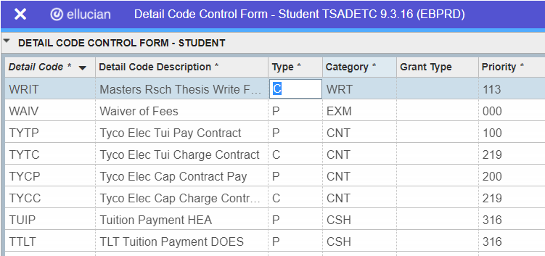
New to Navigation -
Sort By Column
Columns whose title is followed by an * (asterisk) can be used to sort the records, a triangle displays once applied.
This may also work on columns that do not have an asterisk.
If sort can’t work on a column, an error will display in the message center.

Slide 44
New to Navigation -
Change Column Size (Not Sticky)
You can resize columns by hovering over the line between column headings until you see and dragging it.

Slide 45
New to Navigation -
Drag Columns (Not Sticky)
Columns can be moved by: Clicking on the column heading and dragging the column to desired place and releasing it.
Please note this is not sticky, the moment you refresh your page you will lose the arrangement.

Slide 46
New to Navigation -
Icon Labels
When you resize your window, the labels for the icons may disappear.
Icons will always remain visible.

