Slide 1
Session Title
Lecturer name and photo
This webinar will start at (give time & date)

Slide 2
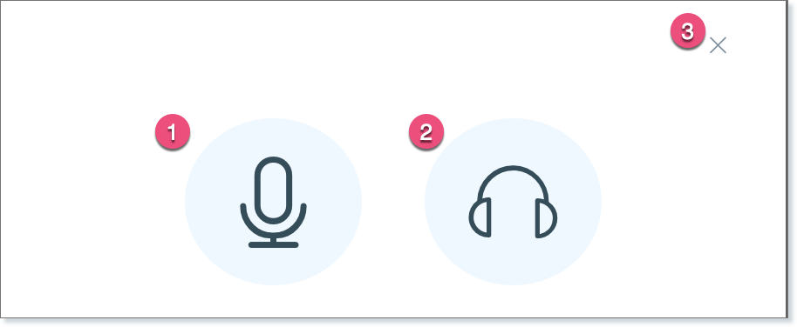
(1) To speak/present during the webinar you need to join the room by clicking on the microphone icon. Please note: you will need to allow permission for your browser to access your mic.
(2) To listen only, enter the room by clicking on the headphone icon.
(3) If you clicked on the X, you will be unable to speak or listen during the webinar

Slide 3
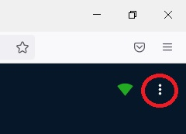
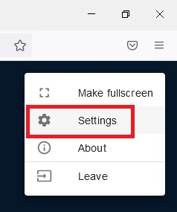
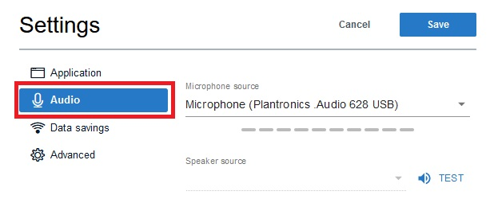
'Allow' your microphone if prompted. If you need to change your audio settings, chose the ellipsis menu from the top-right of your screen, then choose 'settings' and Audio'.

Slide 4
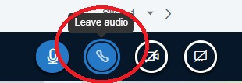
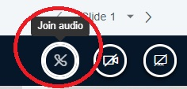
If you chose to enter the room as ‘listen only’ but realise that you should have entered with your mic on, click the ‘leave audio’ icon at the bottom of the screen, then click again to join audio. This will present you once again with the option to choose your mic and re-join the live session with the ability to talk.

Slide 5
Still can’t hear anything?
Use this website to check if your microphone is set up properly
https://www.onlinemictest.com/
Then please log back into the webinar and run through the echo test and audio settings again

Slide 6
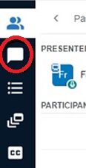
Everyone can use the chat tool to communicate. The chat can be opened by clicking on the chat bubble on the left hand menu.

