Slide 1


School of [Discipline]
Student Orientation in the Use of GenAI for Learning.
With thanks to the Learning, Teaching and Assessment Team:
https://www.tudublin.ie/explore/about-the-university/academic-affairs/lta/

Slide 2

What is Generative AI (GenAI)?
OK, so we think you probably already know an awful lot about GenAI, but just in case, let’s say what it is - GenAI is a type of Artificial Intelligence that is designed to generate new things like writing text, drawing pictures, or making music, all by learning patterns from existing data.
It is essential to understand that “Generative AI is not based on true understanding or grounded knowledge; it operates on statistical patterns that mimic human thinking, work, and creativity.”

Slide 3

What is Generative AI (GenAI)?
Programs like ChatGPT, Co-Pilot, Claude, and Midjourney are examples of GenAI.

Slide 4
Why it is important?
GenAI is growing in popularity, and it is being used in many areas:
  It is used in industry, research, entertainment, and education
  It helps with coding, content creation, and automation
  You’ll likely work with this type of tech in your journey

Slide 5
Generative AI (GenAI)
Different subjects that you are doing will look at different aspects of GenAI, and when you are doing assessments for some subjects, the lecturers will allow you to use GenAI to help you complete those assessments, but for other subjects you won’t be allow to use GenAI in those assessments.

Slide 6
Generative AI (GenAI)
It is really, really important that you understand which subjects you are taking that don’t allow you to use GenAI in assessment, and which ones do.
And for the ones that do allow you to use them, you need to be sure in which ways you are allowed to use GenAI in those assessments.

Slide 7

Generative AI (GenAI)
We will prepare you to navigate uncertainty and technological transformation by exploring Generative AI.
But here's something important to keep in mind:
      Do not use GenAI tools (like ChatGPT, DALL·E, GitHub Copilot, etc.) for assignments or coursework unless your lecturer gives clear permission.

Slide 8
Generative AI (GenAI)
Different lecturers will wish you to use GenAI to different degrees.
So some might say “No GenAI allowed”, and others may say “GenAI allowed for everything”, and even others might say “GenAI for some things and not others”.

Slide 9
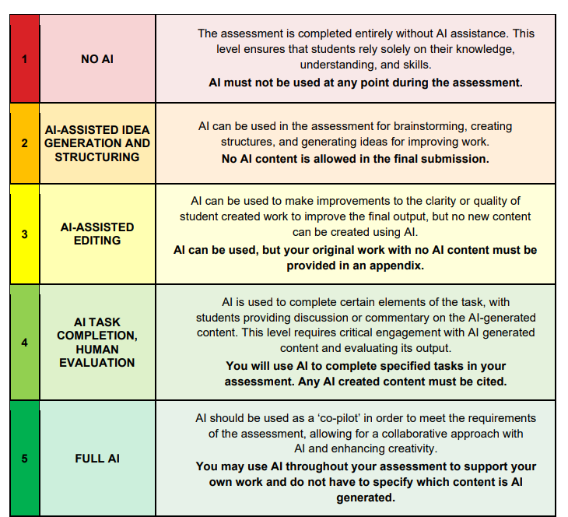
<<< Here is a scale, from “No AI” to “Full AI”, with three possibilities of usage in between (Furze, 2023)
Notes:
Furze, L. (2023) The AI Assessment Scale: From no AI to full AI – Leon Furze. URL https://leonfurze.com/2023/04/29/the-ai-assessment-scale-from-no-ai-to-full-ai/ (accessed 6/6/23).

Slide 10
Why it is important?
It’s vitally important that you develop your own understanding and skills, and make your university experience as rich as possible.
Using GenAI without permission can count as academic misconduct.
So please always ask if you are unsure, we are here to help!

Slide 11
Why it is important?
Rule-of-thumb:
“If you wouldn’t copy it from the Internet, don’t copy it from GenAI either.”
So, let’s learn the tools, but use them wisely.

Slide 12
Thanks !!!
Acknowledgements:
Mr. Damian Gordon
Dr. Markus Hoffman
Dr. Ana Schalk

