Slide 1
Week 1:
What is GenAI?

Slide 2
Contents
What is GenAI?
Difference between traditional AI and GenAI
Content Generation
ACTIVITY

Slide 3
What is
Generative AI?

Slide 4
What is Generative AI (GenAI)?
OK, so you probably already know a lot about GenAI, but just in case, let’s say what it is – Generative AI is a type of Artificial Intelligence that is designed to create new things like writing text, drawing pictures, or making music, all by learning patterns from existing data.

Slide 5
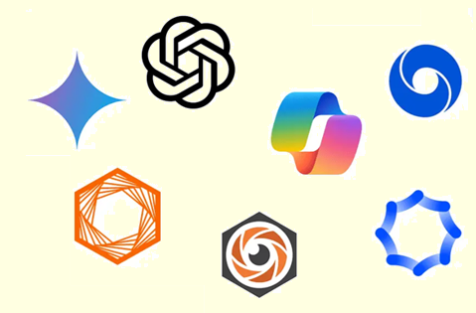
What is Generative AI (GenAI)?
Programs like ChatGPT, Claude, Co-Pilot, and Midjourney, are examples of GenAI.

Slide 6
Why it is important?
GenAI is growing in popularity, and it is being used in many areas:
  It is used in industry, research, entertainment, and education
  It helps with coding, content creation, and automation
  You’ll likely work with this type of tech in your journey

Slide 7
Generative AI (GenAI)
Different subjects that we are doing will look at different aspects of GenAI, and when we are doing assessments for some subjects, the lecturers will allow us to use GenAI to help us complete those assessments, but for other subjects we won’t be allow to use GenAI in those assessments.

Slide 8
Generative AI (GenAI)
It is really, really important that we understand which subjects we are taking that don’t allow us to use GenAI in assessment, and which ones do.
And for the ones that do allow us to use them, we need to be sure in which ways we are allowed to use GenAI in those assessments.

Slide 9
Generative AI (GenAI)
We're excited for you to explore Generative AI.
But here's something important to keep in mind:
Please don’t use AI tools (like ChatGPT, DALL·E, GitHub Copilot, etc.) for assignments or coursework unless your lecturer gives clear permission.

Slide 10
Difference between traditional AI and GenAI

Slide 11
History of Artificial Intelligence
Artificial Intelligence (AI) began as a field of research in the 1950s, when scientists started exploring whether machines could imitate human thinking.
The term "Artificial Intelligence" was officially coined at a key conference in Dartmouth, New Hampshire in 1956, marking the birth of AI as a discipline.

Slide 12
History of Artificial Intelligence
Over the following decades, AI evolved from simple rule-based systems and expert systems to powerful machine learning and deep learning models.
Major milestones include IBM's Deep Blue defeating world chess champion Garry Kasparov in 1997, IBM Watson winning Jeopardy! in 2011, and AlphaGo defeating Go champion Lee Sedol in 2016.

Slide 13
History of Artificial Intelligence
In 2022, AI entered the era of Generative AI, with systems such as ChatGPT, Gemini, Claude, and Midjourney capable of creating text, images, audio, and video, transforming how people learn, work, and create.

Slide 14
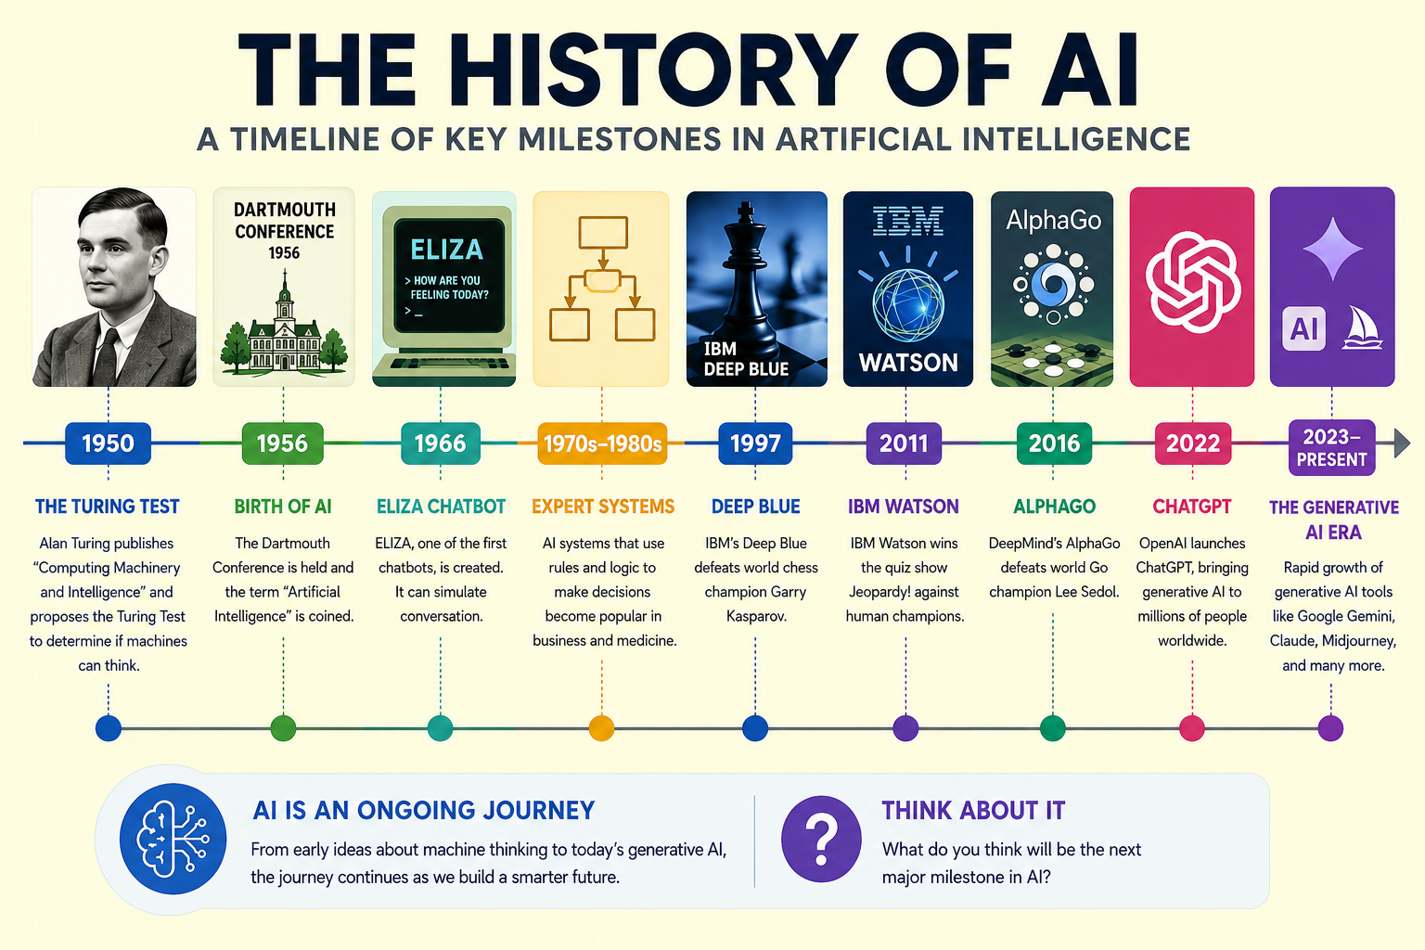

Slide 15
Traditional AI and Generative AI
In the past, AI systems were mostly built and used by computer scientists, engineers, and large organisations. Today, Generative AI tools such as ChatGPT and Gemini allow everyday users to interact with AI using simple natural language, making AI more accessible than ever before.

Slide 16
Traditional AI and Generative AI
Traditional AI focuses on analysing data, recognising patterns, and making predictions. For example, it can detect spam emails, recommend movies, or recognise faces in photos.
Generative AI (GenAI), on the other hand, is designed to create new content. It can generate text, images, music, and videos based on a user's prompt.

Slide 17
Traditional AI and Generative AI
While traditional AI answers questions about existing data, Generative AI creates something new from the information it has learned, making tools such as ChatGPT, Gemini, Claude, and Midjourney possible.
It is worth noting that GenAI is not as much about facts or knowledge, as it is about learning and using patterns that follow a model.

Slide 18
Content Generation

Slide 19
Content Generation
Generative AI is changing how we create and consume information. With a few words, a user can generate text, images, audio, video, or computer code in seconds. This has made content creation more accessible than ever before, allowing people with little technical expertise to produce work that previously required years of training.

Slide 20
Content Generation
Text Generation: Generative AI can create written content such as essays, emails, stories, summaries, computer code, and answers to questions. Tools like ChatGPT, Co-Pilot, and Claude can generate text in different styles. For example, a student might ask an AI tool to explain photosynthesis in simple language or create revision notes from a textbook chapter.

Slide 21
Content Generation
Text Generation Tools:
ChatGPT
Microsoft Copilot
Claude
Google Gemini

Slide 22
Content Generation
Image Generation: Generative AI can create original images from text descriptions. A user simply describes what they want, and the AI generates a picture to match. For example, a prompt such as "an apple floating in space in a cartoon style" can produce a completely new image. Tools such as Midjourney and DALL·E are popular image generators.

Slide 23
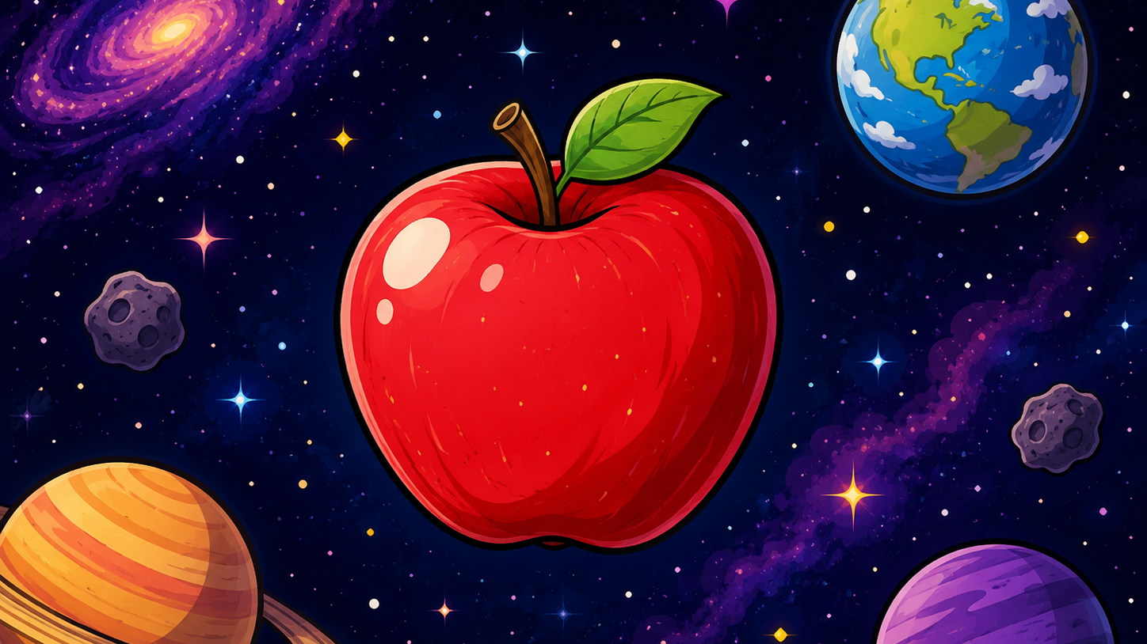

Slide 24
Content Generation
Image Generation: For example, a prompt such as “design a city of the future“ would give the following:

Slide 25
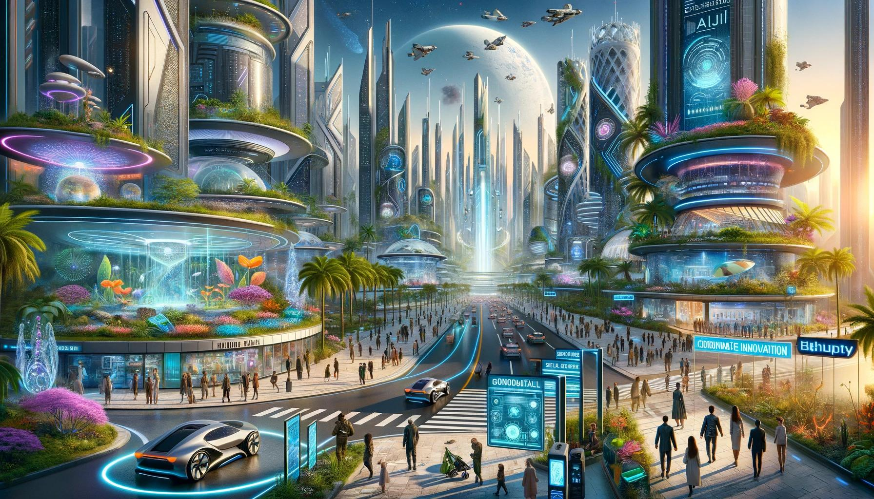

Slide 26
Content Generation
Image Generation Tools:
Midjourney
DALL-E
Adobe Firefly
Stable Diffusion

Slide 27
Content Generation
Audio Generation: Generative AI can create speech, music, and sound effects. It can generate realistic voices, read text aloud, or compose original songs. For example, AI can create a podcast narration, produce background music for a video, or generate a voice in different accents and languages.

Slide 28
Content Generation
Audio Generation Tools:
Suno
ElevenLabs
Murf
Speechify

Slide 29
Content Generation
Video Generation: Generative AI can create videos from text prompts, images, or existing footage. It can generate animations, educational videos, and realistic video clips. Modern tools can create short videos simply by describing a scene, such as "a robot cooking dinner in a futuristic kitchen."

Slide 30
Content Generation
Video Generation Tools:
Runway
Synthesia
Sora
Pika

Slide 31
Content Generation
Code Generation: Generative AI can write, explain, debug, and improve computer code. By describing a problem in natural language, users can ask AI tools to generate programs in languages such as Python, Java, JavaScript, C++, and many others. AI can also explain what code does, find errors, suggest improvements, and help programmers learn new concepts.

Slide 32
Content Generation
Code Generation Tools:
Amazon Q Developer
Codeium
Tabnine
Replit Ghostwriter

Slide 33
ACTIVITY

Slide 34
Activity
Steps
1. Open Copilot and one other GenAI tool.
2. Enter the following prompt into both tools:
  Create a recipe for a green pizza.
3. Compare the differences and similarities you got.
4. Compare with two other people in your class.

Slide 35
Activity
Why were the answers different?
Different training data
Different model designs
Randomness in generation
Different interpretations of the prompt
Key Takeaway: GenAI AI just is a tool, and is not a learning shortcut. The most important part of this activity is the comparison of outputs and our critical thinking.

Slide 36
Thanks !!!

