Slide 1
Week 4:
Using GenAI for Learning

Slide 2
Contents
How GenAI Can Support Learning
Academic Integrity and GenAI
Good Uses and Bad Uses of GenAI
ACTIVITY

Slide 3
How GenAI Can
Support Learning

Slide 4
How GenAI Can Support Learning
GenAI can be a powerful study tool when used well.
The most effective use of GenAI is as a learning assistant, not as a replacement for thinking and studying.
Used well, GenAI can expand your learning.

Slide 5
How GenAI Can Support Learning
It can help us:
Understand complex topics
Summarise large amounts of information
Elaborate study materials
Generate practice questions
Support revision and exam preparation

Slide 6
How GenAI Can Support Learning
Understanding Complex Topics
Provide step-by-step explanations
Use simpler language
Provide real world examples, and analogies
Adjust explanations for different levels of knowledge
Example Prompt:
Explain [TOPIC] as if I were a 10 year-old.

Slide 7
How GenAI Can Support Learning
Summarise Large Amounts of Information
Summarise journal articles
Condense lecture notes
Highlight key concepts
Elaborate study guides
Important Note:
Always compare summaries with the original source.

Slide 8
How GenAI Can Support Learning
Elaborate Study Materials
Revision notes
Flashcards
Mind maps
Glossaries
Study guides
Important Note:
Remember to review materials for accuracy, ALWAYS.

Slide 9
How GenAI Can Support Learning
Generating Practice Questions
Multiple-choice questions
Short-answer questions
Quiz questions
True/False questions
Exam-style questions
Example Prompt:
Create 10 quiz questions on [TOPIC] for beginners.

Slide 10
How GenAI Can Support Learning
Supporting Revision and Exam Preparation
Create revision plans
Generate mock exams
Explain incorrect answers
Test knowledge through quizzes
Suggest topics for further study
Important Note:
GenAI should be used to support revision rather than replace it.

Slide 11
Fun Ways of Learning

Slide 12
How GenAI Can Support Learning
Fun Ways of Learning
Role-Play with Historical Figures
Create a Mystery Game
Debate an AI
Create a Song, Poem or Rap
Create a Text Adventure

Slide 13
How GenAI Can Support Learning
Role-Play with Historical Figures
Ask GenAI to act as: Albert Einstein, Ada Lovelace, Alan Turing, Marie Curie, etc.
We can interview famous figures about their discoveries.
Example Prompt:
Pretend you are Alan Turing. Answer my questions about computing.

Slide 14
How GenAI Can Support Learning
Create a Mystery Game
Turn a topic into a detective story. Transform revision into a detective adventure where each clue reveals new knowledge. Learn through investigation by solving puzzles that require subject knowledge to progress.
Example Prompt:
Create a murder mystery where the clues teach me about data privacy laws.

Slide 15
How GenAI Can Support Learning
Debate an AI
Challenge the AI to defend an opposing viewpoint. This encourages us to think critically, evaluate evidence, identify weaknesses in arguments, and develop stronger reasoning and communication skills.
Example Prompt:
Argue that social media has more benefits than drawbacks.

Slide 16
How GenAI Can Support Learning
Create a Song, Poem or Rap
Turn difficult concepts into songs, poems, or raps to make them easier to remember. Music and rhythm can help improve memory and make revision more engaging and enjoyable.
Example Prompt:
Write a rap explaining the difference between supervised and unsupervised learning.

Slide 17
How GenAI Can Support Learning
Create a Text Adventure
Turn learning into an interactive story where your choices determine what happens next. Instead of simply reading about a topic, you learn by solving problems, answering questions, and making decisions within the story.
Example Prompt:
Create a text adventure where I investigate social inequality in a city and learn about class, poverty, and social mobility.

Slide 18
Academic Integrity and GenAI

Slide 19
Academic Integrity and GenAI
Academic integrity means being honest and responsible in our academic work.
We should only submit work that genuinely reflects our own learning.
Using GenAI does not remove our responsibility for the final submission.

Slide 20
Academic Integrity and GenAI
GenAI can support learning, but misuse can undermine academic integrity. Potential Issues include:
Submitting AI-generated work as our own
Using AI to complete assessments without permission
Fabricating references or sources
Over-reliance on AI instead of learning

Slide 21
Academic Integrity and GenAI
Different lecturers will wish us to use GenAI to different degrees.
So some might say “No GenAI allowed”, and others may say “GenAI allowed for everything”, and even others might say “GenAI for some things and not others”.

Slide 22
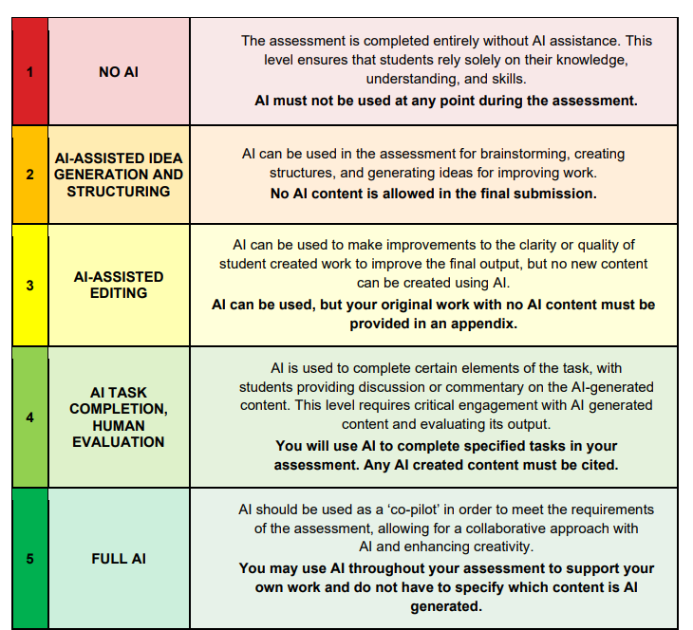
Here’s a scale, from “No AI” to “Full AI”, with three levels of usage in between:
1. No AI permitted
2. Limited AI support
3. AI-assisted work
4. AI collaboration
5. AI-integrated assessment

Slide 23
Academic Integrity and GenAI
It’s vitally important that we develop our own understanding and skills, and make our university experience as rich as possible.
Using GenAI without permission can count as academic misconduct.
So we should always ask if we're unsure!

Slide 24

Academic Integrity and GenAI
The TU Dublin Library provides a clear set of instructions of how to cite and reference the use of GenAI correctly.
https://tudublin.libguides.com/GenAI/referencing

Slide 25
Academic Integrity and GenAI
The TU Dublin Academic Integrity page provides a clear overview of why honesty matters in higher education, and what counts as misconduct, and the consequences of breaching academic integrity policies.
https://www.tudublin.ie/explore/about-the-university/academic-affairs/academic-quality-assurance-and-enhancement/academic-integrity/

Slide 26
Academic Integrity and GenAI
KEY TAKEAWAY
GenAI can be an effective learning assistant when used responsibly to: Understand concepts, Summarise information, Create study materials, and Support revision
Do not use it to: Replace your own learning, or Complete assessments dishonestly
The goal is to learn with AI, not let AI learn for you.

Slide 27
Good Uses and Bad Uses of GenAI

Slide 28
Good Uses and Bad Uses of GenAI
Using GenAI to support learning can improve understanding, revision, and study skills. However, using it to avoid learning or complete assessments dishonestly can undermine academic integrity. The key question is:
Is GenAI helping us learn, or doing the learning for us?
Let's look at some examples of appropriate and inappropriate uses of GenAI in education.

Slide 29

Good Uses and Bad Uses of GenAI
Examples of appropriate use:
✓ Summarising readings
✓ Creating revision notes
✓ Brainstorming ideas,
✓ Generating practice questions
✓ Explaining difficult concepts
✓ Creating study schedules
These uses support learning without replacing it.

Slide 30

Good Uses and Bad Uses of GenAI
Examples of inappropriate use:
✗ Submitting AI-generated assignments as your own
✗ Generating essays without understanding them
✗ Using fabricated references
✗ Circumventing assessment requirements
✗ Copying GenAI output without verification
✗ Letting GenAI doing the thinking
These practices breach academic integrity policies.

Slide 31
Good Uses and Bad Uses of GenAI
Good Use
"I don't understand this concept. Can you explain it differently?"
Bad Use
"Write my assignment for me."
The difference is whether AI supports learning or replaces learning.

Slide 32
Good Uses and Bad Uses of GenAI
Good Use
"Create a quiz to help me revise."
Bad Use
"Complete my online test.“
Again, the difference is whether AI supports learning or replaces learning.

Slide 33
ACTIVITY

Slide 34
Activity
Create Your Own Study Assistant
Working in pairs:
Choose a topic you are currently studying.
Use GenAI to generate: A summary, A short quiz, and Flashcards
Evaluate the quality of the output. Check for errors or missing information.

Slide 35
Activity
Discussion Questions:
Did the summary capture the key ideas?
Were the quiz questions useful?
Were any answers incorrect?
How could the prompts be improved?
Would these materials help you revise?

Slide 36
Further Reading
TU Dublin Generative AI Guide
https://tudublin.libguides.com/GenAI
AI Assessment Scale (AIAS)
https://aiassessmentscale.com
UNESCO Guidance for Generative AI in Education
https://www.unesco.org
JISC Generative AI Resources
https://www.jisc.ac.uk

Slide 37
Thanks !!!

