Slide 1

Information for Practice Educators on Student Mental Health Issues and Supports

Slide 2
Mental Health
Signs of mental health difficulties may present in some of the following ways:
Marked deterioration in work quality
Change in mood: increase in low mood, irritability etc..
Changes in appetite much higher/lower
Difficulty concentrating
Sleep difficulty
Changes in physical presentation: decline in hygiene, unkempt appearance
Increase in anxiety levels
Social withdrawal and loss in interests previously enjoyed
Paranoid/bizarre ideas

Slide 3
Addressing Concerns
Situations where another student appears withdrawn, low in mood, tearful or unduly anxious but is not at immediate risk. Consider one or more of the following courses of actions:
When addressing your concerns, ensure that you have a private, appropriate space to raise to discus these i.e; not in a setting where others may overhear the conversation or interrupt.
Make them aware of your concern and the basis for that concern. It is useful to name the specific change in behaviour(s) that has caused you to feel concerned. For example:
‘I’m concerned about you, Adam. You usually engage well with your work and the team but I notice recently, you appear more distracted and withdrawn. I’m wondering if everything is ok or if there’s something you might need help or support with?’

Slide 4
Addressing Concerns
Advise them to consider obtaining support and share information on support services available to them.
Offer to support them in contacting their GP, Student Counselling Service, Student Health Service, Chaplaincy & Pastoral Care team, if they would like help with this.
Offer to meet again to follow up with them if they would like to do this
If there is no immediate risk to the student or others and they don’t want to avail of support services, or don’t want to follow your advice, their wishes should be respected.

Slide 5
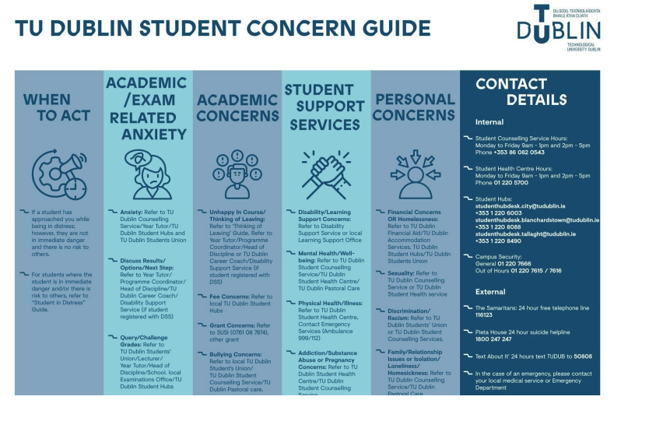

Slide 6
When Supporting A Student
Recognise your boundaries & limits.
There are No Magic Answers.
Your concern, and the fact that you are taking the person seriously is far more important than you realise
Use caution around confidentiality. It may be necessary to consult with a colleague/TU Dublin placement co-ordinator and seek support and guidance if there is a more serious concern.

Slide 7
When Supporting A Student
The TU Dublin Student Mental Health Policy can be a useful reference point for further guidance and information about the services available in the University:
https://www.tudublin.ie/media/website/explore/about-the-university/academic-affairs/assessment-/TU-Dublin-Students-Mental-Health-Policy-.pdf
Not expected to be a mental health professional:
Listen
Support
Refer

