Slide 1
GetAHEAD & WAM Programmes Love Your Career
Hannah Kelly|
Student & Graduate Engagement Officer

Slide 2
Agenda
What is WAM/GetAHEAD?
Benefits for Graduates
Benefits for Employers
WAM Database
Upcoming WAM Placements

Slide 3
Vision
Shaping an inclusive future where students and learners with disabilities can succeed
Willing, Able, Mentoring …ensuring employers understand disability
The WAM Programme was established in 2005 and is currently funded by the Department of Social Protection. The central objective of WAM is to widen access to employment for graduates with disabilities while working with and supporting employers to create more inclusive workplaces.
We set to achieve this strategically primarily through our work placement programme; over 550 placements secured to date in both the public and private sector.
Notes:
Caroline McGrotty

Slide 4
GetAHEAD Workshops
Four upskilling workshops during the year:
CV Building
Reasonable Accommodation and AT
Resilience
Disclosure
Yearly bootcamp with employers:
Networking
Assessment Centres
LinkedIn

Slide 5
What is a WAM Placement?
6 months minimum
Fully Paid
Needs Assessment
Mentoring

Slide 6
Willing, Able, Mentoring
https://www.youtube.com/watch?v=YXQj9boMXEQ

Slide 7
Graduate Benefits
Upskilling workshops with GetAHEAD
Paid work experience
Career development
A safe space to disclose
A comprehensive Needs Assessment to identify supports in the workplace
Support of a company mentor on site
Ongoing support from WAM throughout
Enrolment into WAM’s online course
Improved confidence

Slide 8
Benefits for Employers
Disability proofing HR and recruitment practices
Access to our graduate database
Training for HR staff and line managers on disability
A safe space to ask questions
A comprehensive needs assessment recommending supports to be put in place
Advise on workplace supports and accommodations

Slide 9
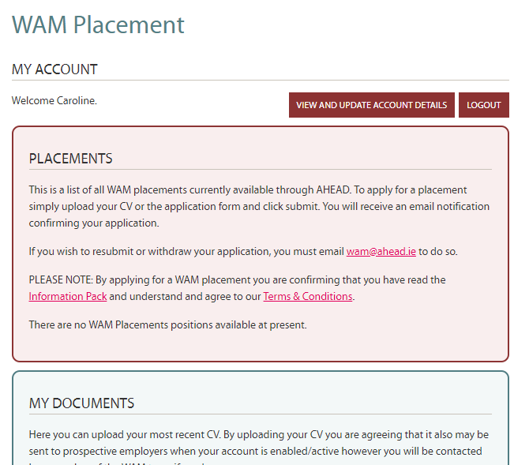
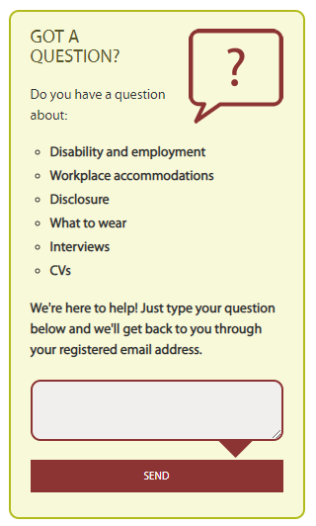
WAMWorks Database

Slide 10
Join the World of Work with #WAMWorks
Mentored, paid work for graduates
Have a disability, specific learning difficulty or mental health condition
Have (or will soon have) a Level 6 qualification or above
Ready to undertake a full-time, graduate level role
Be in with a chance to win a One4all voucher if you register before 23rd January

Slide 11
Upcoming WAM Placements
Company | Role | Recruitment | Start Date | Location
Optum | Tech Development Programme | February 23rd | September 2022 | Donegal
Civil Service | Multiple roles | February | June 2022 | Multiple Locations
Central Bank | Grad Programme | TBC | September 2022 | Dublin
ESB | Multiple Roles | Ex Advertising June | September 2022 | Dublin/Cork
Bank of Ireland | Grad Programme | TBC | October 2022 | Dublin

Slide 12
We know WAM Works!
80% secured full-time work within 12 months
94% of graduates gained confidence in their ability to work in a mainstream environment
“
If it wasn’t for WAM, I would still be on the equivalent of the Disability Allowance which is €188 a week….
(WAM Graduate)
“

Slide 13
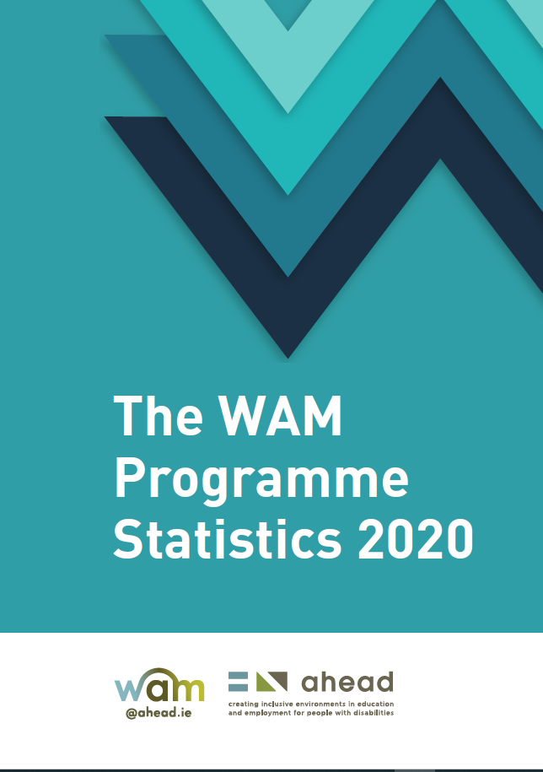
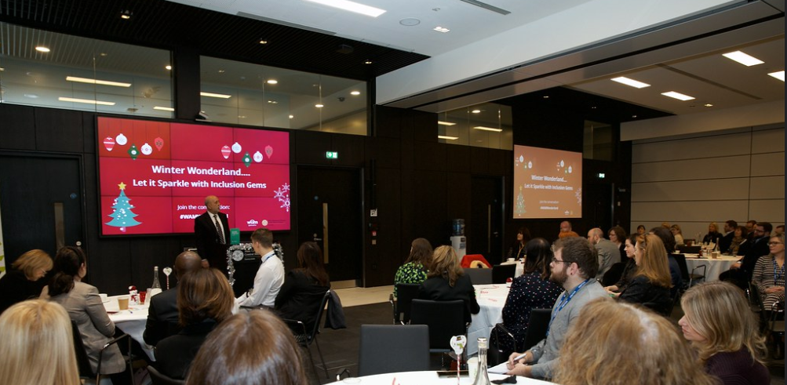
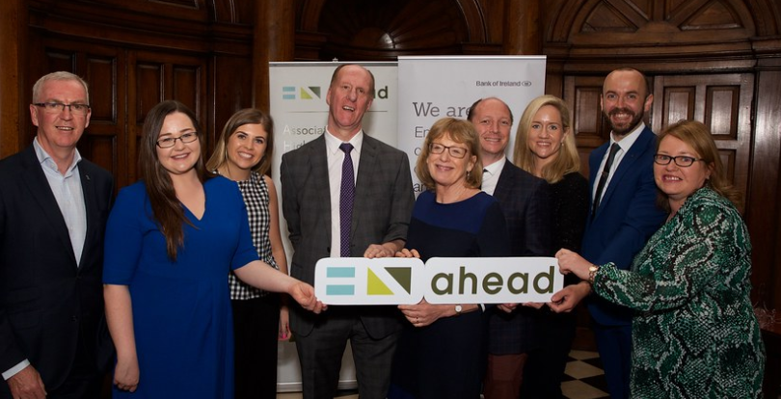
WAM Contact details and more info
Website www.ahead.ie/wam | Email wam@ahead.ie | Phone 01 716 8844
WAM Programme Statistics
Ally Ship

