Slide 1
17th February 2022
Career Resources for LGBTI+ Students
www.tudublin.ie/careers/loveyourcareer
Christiane Brennan

Slide 2
Introduction
Finding positive employers
Disclosure
References
On-Line Presence

Slide 3
“A survey of successful job hunters revealed that the most successful job seekers spent time talking to people in various businesses and organisations before they began actively seeking employment”
Richard Bolles:
“What Colour is your Parachute?”

Slide 4
LGBTI+ NETWORK

Slide 5
How to use your network

Slide 6
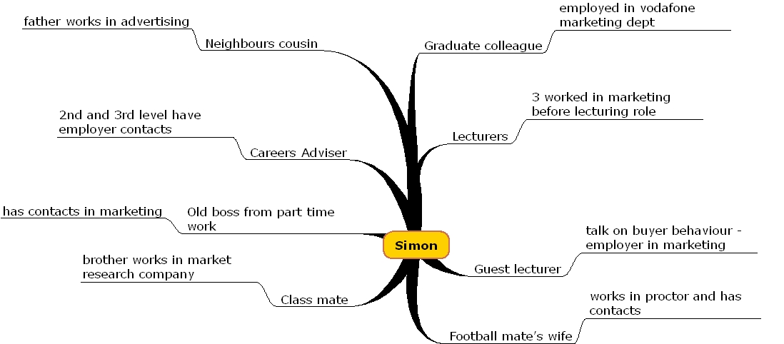

Slide 7
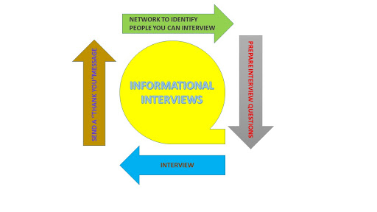

Slide 8
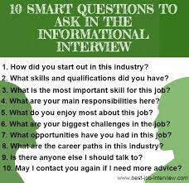
10 SMART QUESTIONS TO ASK IN THE INFORMATIONAL INTERVIEW
How did you start out in this industry?
What skills and qualifications did you have?
What is the most important skill for this job?
What are your main responsibilities here?
What do you enjoy most about this job?
What are your biggest challenges in the job?
What opportunities have you had in this job?
What are the career paths in this industry?
Is there anyone else I should talk to
May I contact you again if I need more advice?

Slide 10
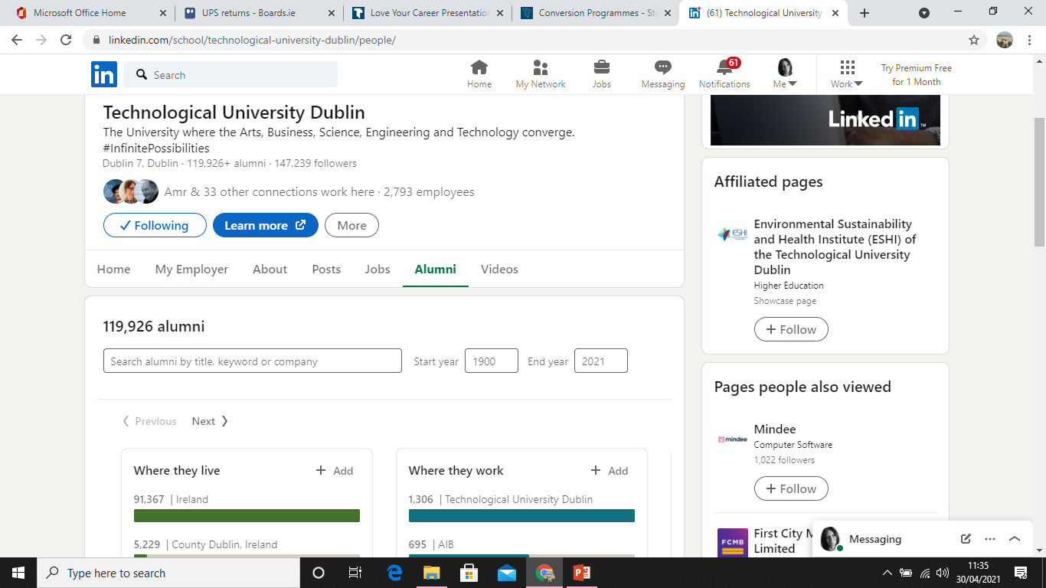

Slide 11
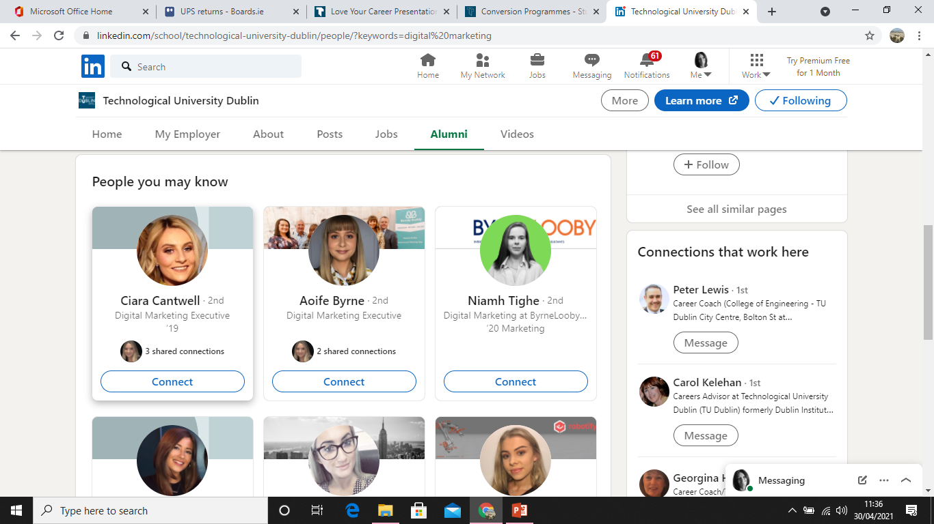

Slide 12
Investigate Employer Attitude
Participation in Pride
Website
Publications & Articles
Social Media
Diversity Initiatives / Sponsorship of events
Value Statements
Non Discrimination Statements

Slide 13
Dig Deep

Slide 14
Human Rights Campaign Foundation’s Corporate Equality Index is the US national benchmarking tool on corporate policies, practices and benefits pertinent to lesbian, gay, bisexual, transgender and queer employees.

Slide 16
Legality
Organisation Attitude
Promote LGBTI+ Activities
Personal Experience
Positivity
Pros & Cons
To disclose or not to disclose…. That is the question

Slide 19
Useful Resources
www.tudublin.ie/careers
Students and Graduates
Job Hunting, CVs, Interviews
www.gradireland.com
www.tudublin.ie/careersconnect
www.lgbt.ie
www.teni.ie
www.belongto.org

