Slide 1
17th February 2022
Career Tips for International Students
www.tudublin.ie/careers/loveyourcareer
Christiane Brennan

Slide 2
Tips
Use all usual methods of Job Hunting
Attend Job Hunting webinars and seminars
Use Job Hunting help on www.tudublin.ie/careers
Contact your Career Coach

Slide 3
Enhance your knowledge
Before Job Hunting
Research area
Get a Mentor
Network with Professionals
Follow trade Associations
Attend Virtual events
Research Industry

Slide 4
International NETWORK

Slide 5
How to use your network

Slide 6
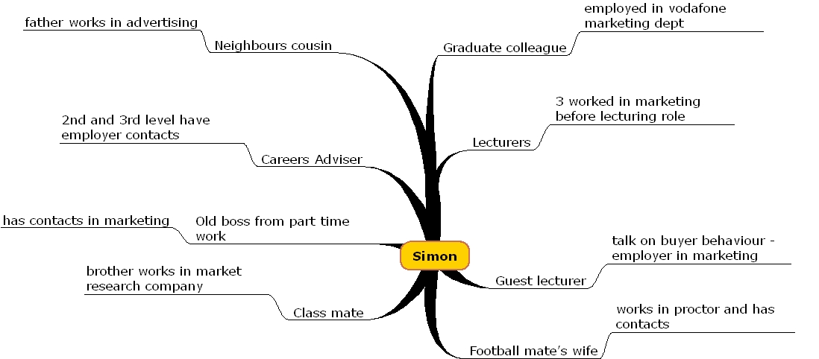

Slide 7
“A survey of successful job hunters revealed that the most successful job seekers spent time talking to people in various businesses and organisations before they began actively seeking employment”
Richard Bolles:
“What Colour is your Parachute?”

Slide 9
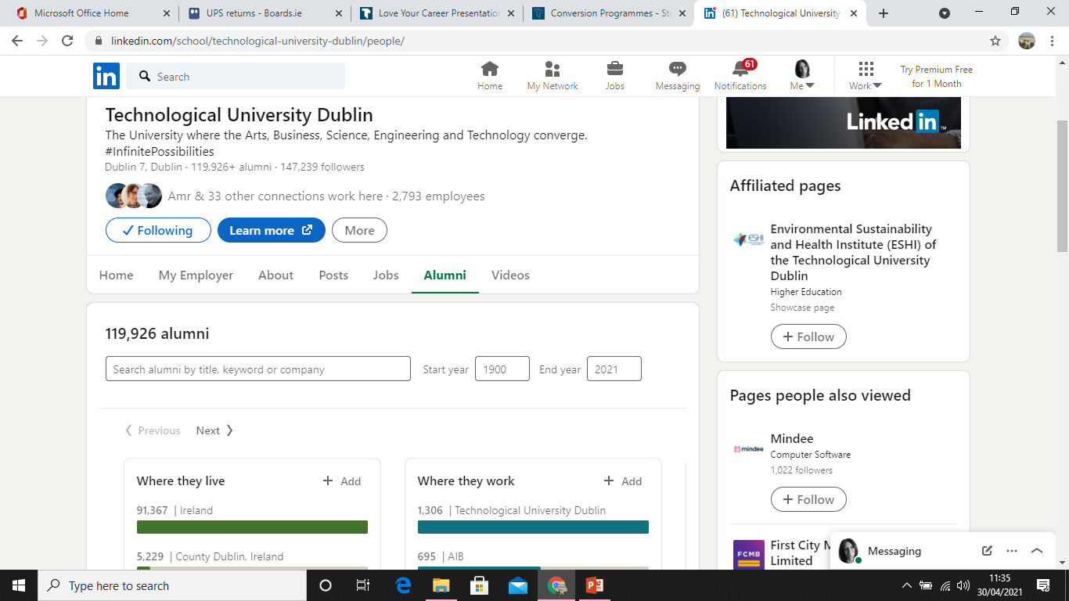

Slide 10
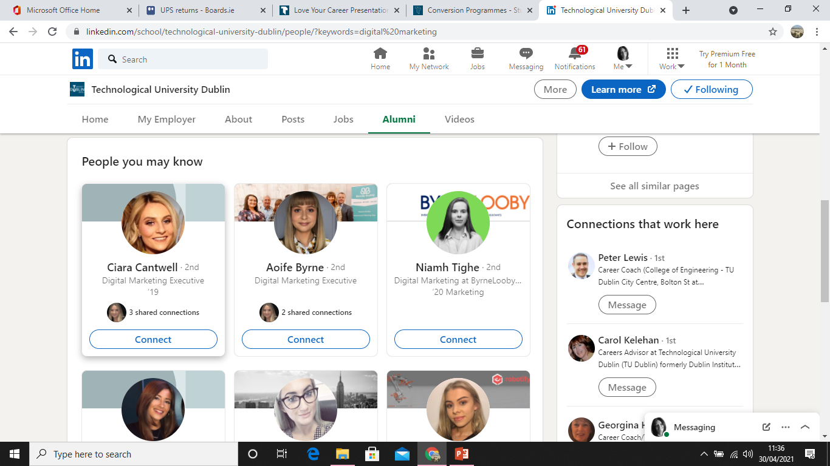

Slide 11
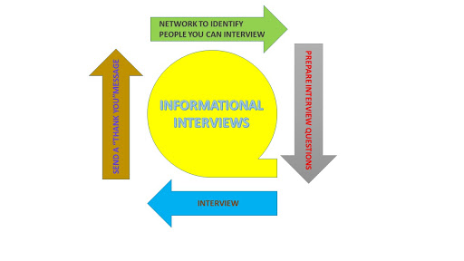

Slide 12
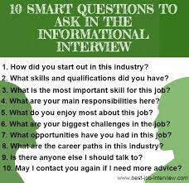
10 SMART QUESTIONS TO ASK IN THE INFORMATIONAL INTERVIEW
How did you start out in this industry?
What skills and qualifications did you have?
What is the most important skill for this job?
What are your main responsibilities here?
What do you enjoy most about this job?
What are your biggest challenges in the job?
What opportunities have you had in this job?
What are the career paths in this industry?
Is there anyone else I should talk to
May I contact you again if I need more advice?

Slide 13
Investigate Employer Attitude
Equality, Diversity and Inclusion (EDI) mark
Attend employer-led events, fairs and workshops
Check out staff profiles / provide diversity training
Website & Social Media – equality statements
Diversity Initiatives / Officers / Sponsorship of events
Equal Opportunities Employer
Non Discrimination / Value Statements

Slide 14
Dig Deep

Slide 15
Get your foot in the door
Information Interviews
Shadowing
Work experience

Slide 16
Final Tips
Take every opportunity to improve your English
Use Irish style applications – attend webinars, use resources on tudublin.ie/careers
Making Applications – get native English speaker to check English
Job Hunting – attend webinars, use resources on tudublin.ie/careers
Interviews – attend webinars. Speak slowly and clearly. Ask them to repeat questions you don’t understand
Get involved – volunteering, extra curricular activities, hobbies, enter competitions

Slide 17
Useful Resources
www.tudublin.ie/careers
Students and Graduates
Job Hunting
CVs
Interviews
www.gradireland.com
www.tudublin.ie/careersconnect

