Slide 1
Friday, 18 February 2022
THE POWER OF NETWORKING:
TU DUBLIN GRADUATE NETWORK
www.tudublin.ie/careers/loveyourcareer
PRESENTER:
Robyn Byrt, TU Dublin Alumni Office

Slide 2
Agenda
Introduction to TU Dublin Graduate Network
Networking 101: Social and Professional
Tips for Networking
Networking on LinkedIn
Q&A

Slide 3
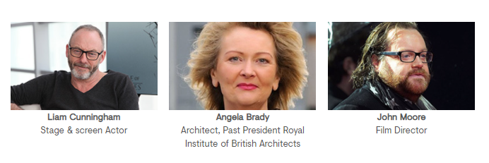
TU Dublin Graduate Network
130,000+ Alumni
https://www.tudublin.ie/connect/graduates/notable-alumni/

Slide 4
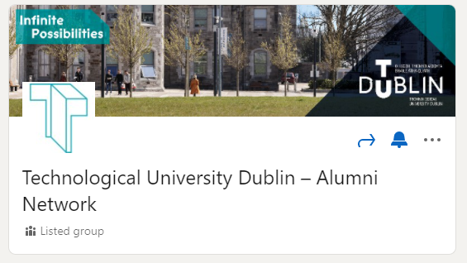
Over 17,000 LinkedIn Group Members
https://www.linkedin.com/groups/83123/
Notes:
130,000 Alumni around the world, all disciplines

Slide 5
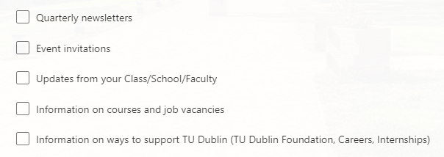
Join the Graduate Network
Graduate Access Card (Gym, Library)
Reunions and Events
10% Discount on Postgraduate Learning
Email Updates
https://www.tudublin.ie/connect/graduates/join-our-graduate-network/
Notes:
130,000 Alumni around the world, all disciplines

Slide 6
Networking 101
Why?

Slide 7
An estimated 80% of jobs are never advertised

Slide 8
Networking 101
Professional Networking
Social Networking

Slide 9
Social or Professional?
Colleagues
Lecturers/
Tutors
Teammates
Classmates
Friends/
Family
Mentors

Slide 10
Notes:
130,000 Alumni around the world, all disciplines

Slide 11
Existing Connections
Networking Opportunities

Slide 12
Tips for Networking
Complete the connection - LinkedIn
Be curious – ask questions!
Open vs Closed Network – the broader the better
Professional or Trade Organisations
Little and Often!

Slide 13
Introductions/First Conversations
Shift your perspective
Ask more questions… or for advice
“Elevator Pitch”

Slide 14
Networking on LinkedIn
Profile Picture
“About”
Experience & Education

Slide 15
Networking on LinkedIn
Skills
Recommendations
Interests

Slide 16
LinkedIn Connections
https://www.linkedin.com/groups/83123/

Slide 17
Thank You – Questions?

