Slide 1
Get Career Ready! Actions to take from now…
Georgina Higgins, Career COACH
Tu Dublin career development centre
businesscareers@tudublin.ie, www.tudublin.ie/careers

Slide 2
Outline of Session
How we can support you
Career actions you can take from now…
Useful resources

Slide 3
Why do students come to us?
Assist you with your career decisions and career choice – next steps
Explore career options related to your course
Further study
Job hunt & network
Applications
Perform at interview
Any career issue!

Slide 4
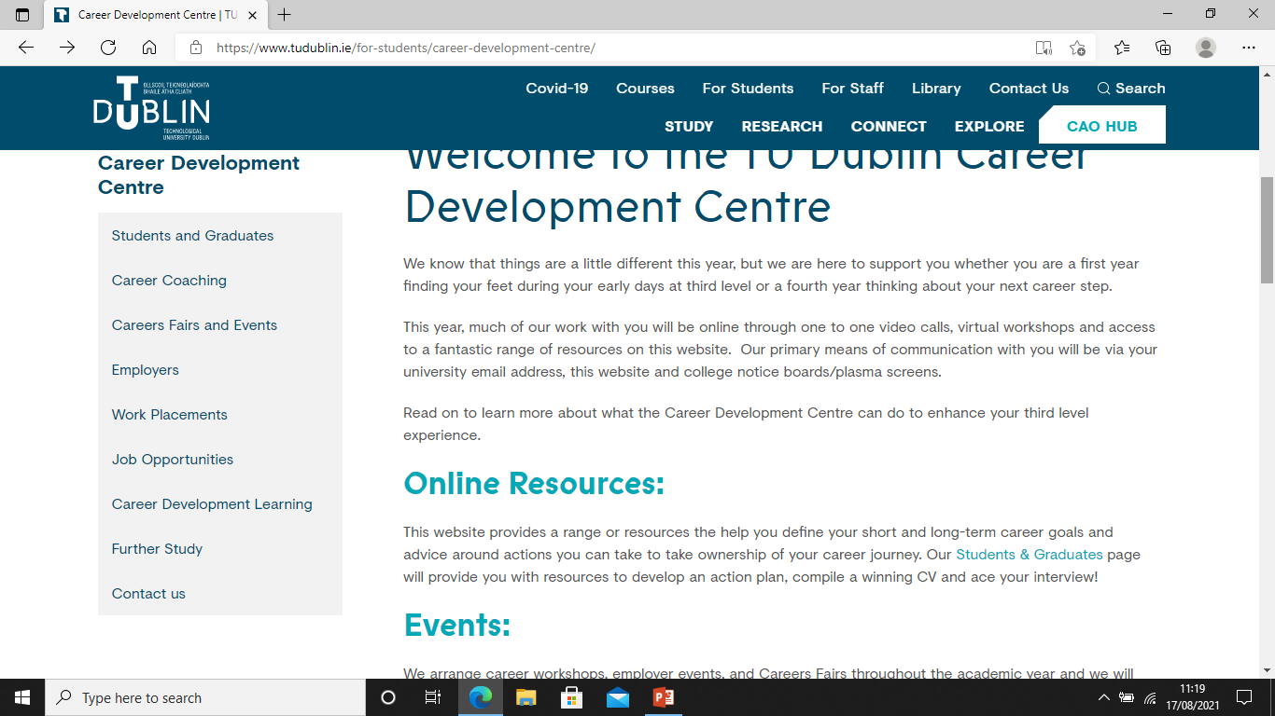
Ways we can help
1-1 Career Coaching
Career Development Workshops
Career Seminars/CV Clinics
Career Events – ‘Get Career Ready’, ‘Love Your Career’, ‘Next Steps’
Employer and Industry Presentations
Careers Fairs
Careers Website: www.tudublin.ie/careers – Comprehensive resources
My Qualification, What Next? (PDF)
https://www.tudublin.ie/for-students/career-development-centre/students-and-graduates/my-qualifications---what-next/

Slide 6
What you can do from now…
Consider and explore your next Career steps and keep options open
Where are the jobs? - Job hunt in as many ways as you can
Online vacancy bulletins – Set up Job Alerts - www.tudublin.ie/jobscene and www.gradireland.com - https://tinyurl.com/Irish-Grad-Programmes - *Deadlines– graduate programmes
Part-time – https://www.tudublinsu.ie/forums/topiclist
Gradireland Directory online - https://lnkd.in/ewe4ntF
Other Career websites: www.gradireland.com, www.nextstepsupport.org, www.careersportal.ie, UK- www.prospects.ac.uk, www.savethestudent.org, www.targetjobs.co.uk
Events diary – Careers Fairs, employer & industry presentations – https://www.tudublin.ie/career-development-centre/careers-fairs-and-events/

Slide 7
Get Career Ready - what you can do from now…
Attend Careers Fairs - Career Development Centre Fairs, Gradireland Graduate Careers Fair and others! – Oct 1st (GradIreland) , 4th (Business/IT/Languages/Law), 20th (Construction/Eng), 21st (Science/Eng)
https://www.tudublin.ie/for-students/career-development-centre/careers-fairs-and-events/virtual-careers-fairs-information-for-students/
Start networking with industry, alumni and others that can help you
Build your CV and Online presence - Brand
Check your student email, noticeboards, plasmas, for updates
Attend Career Development Centre workshops!

Slide 8
What next?...
Immediate Graduate Role/Summer internship
Graduate Programme
Graduate Programme with PG Study
Internship
Traineeship, e.g. Accountancy, Law, etc.
Set up Own Business
Travel
Postgrad Study
Conversion Course

Slide 9
Consider your options What Jobs would suit me?

Slide 10
What Jobs would suit me?- Career-decision Making
Things that are important to you
alues
V
Things that you like to do
I
nterests
Things that suit you
P
ersonality
Things that you can do
S
kills
Notes:
Values are beliefs we develop early in life that make up our fundamental beliefs about what is right and wrong, good and bad. They are shaped by our family, culture, education, religion, and different socialization processes. Some values are maintained throughout our lives, while others may change and become more or less important over time. Examples: Variety, challenge, being able to use expertise, advancement, balance etc.
Exercise
Take the time to consider and list what is most important to you. Once you have listed your values, identify the values that are most and least important to you, and what you would like to have at work, but are not necessary.
Q - What surprises were there for you
Q- What one value stands out from the others
Interests -Thinking about all the activities you participate in college, at work, with your family, friends, volunteering and leisure.
What have you liked and disliked about each activity? Practical, working with other people, technology, detail, escapism,
Personality - Qualities we possess that make us the people we are
Knowing something about our own personality gives us an insight into how we relate to others and our environment.
Skills - Hard, technical v. transferable
Think of achievements or situations when you have excelled. What was the situation?
What skills did you use/learn? What are the ones you enjoy using? What are the ones you are best at?

Slide 11
What Jobs Would Suit Me?- Self-awareness resources
www.prospects.ac.uk Choice to take 2 exercises:
What jobs would suit me?
Career Planner – matches your skills and personality to more than 400 profiles – explore your skills and motivations
Job Match Beta – Allows you explore which job families you belong to. Offers recommendations on what job would suit you from over 400 job profiles. Job family recommendations aim to provide you with a clear idea of where your strengths and skills lie and how you might use them in a future career
www.careersportal.ie - Choice to take 2 exercises:
Interests profiler – click on explore “Career Matching” and “CAO course matching”
Personality profiler

Slide 12
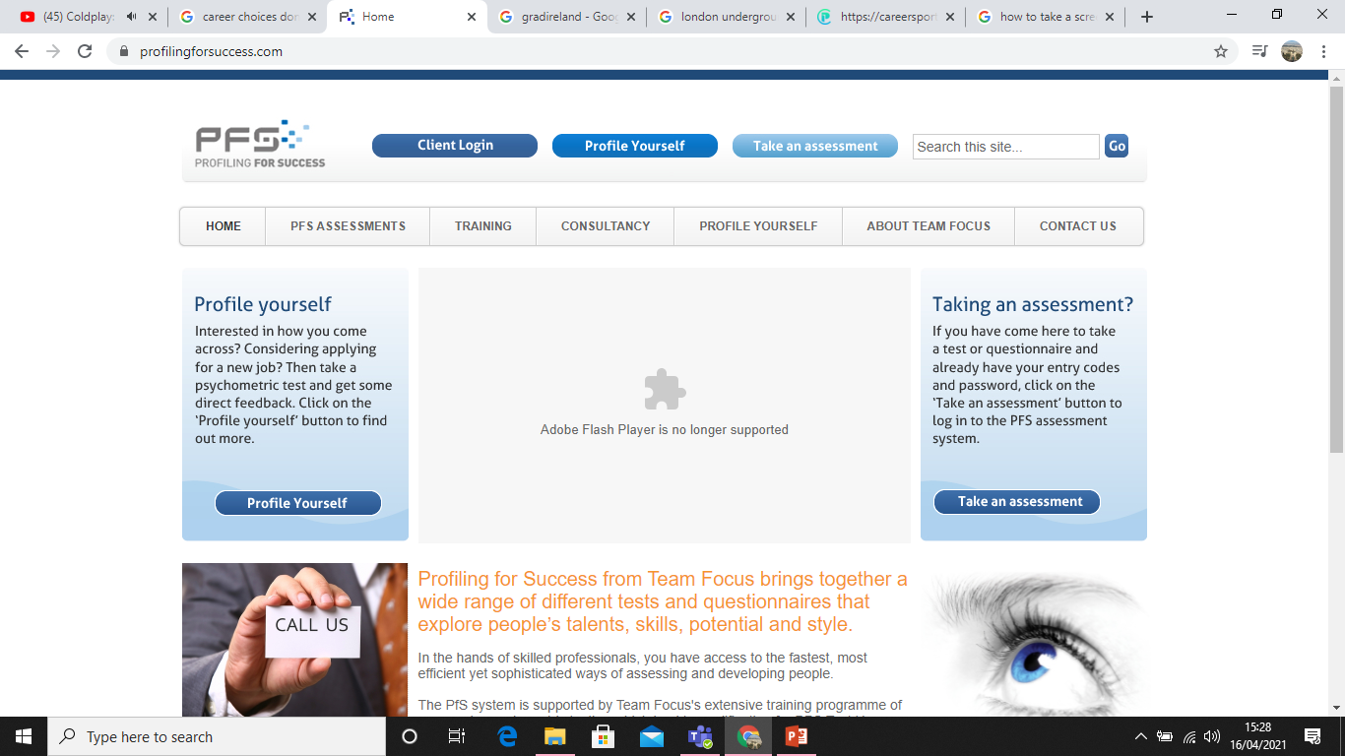
What Jobs Would Suit Me? Self-awareness Resources
Profiling for Success
Take an assessment - Type Dynamics Indicator (personality assessment), Careers Interest Inventory or Values-based Inventory of Motivation
Client Code: tflhe |Access code: dublinit |Password: dub2010 www.profilingforsuccess.com

Slide 13
What you can do from now… *Latest advice from Employers
Be Recruitment Ready
Strong CV, on-line presence, interview skills
When ‘normal’ resumes, there will be a flurry of activity so you need to be ready
There is a slow and steady return
Be flexible. Diversify if necessary
What did you do during this period? Challenges of Covid
Skills and Experience
Consider using extra time to develop skills (online training) – e.g. project management, time management, team work, IT, industry skills, driving licence, etc
Prove your IT capability– ‘remote working skills’, e.g. Skype, Zoom, Brightspace, Teams
Demonstrate qualities of resilience, autonomy, team work, communication
Try and gain experience if you can (e.g. work experience, volunteering, University clubs and societies, outside interests)

Slide 14
Your Career Profile
Can you do the job?
Evidence of Interest/
Motivation
MOTIVATION
SKILLS
PERSONALITY
‘Fit’ for the role/environment/culture
Aptitude/Attitude
Notes:
14
14
14

Slide 15
CAN YOU DO THE JOB?
Education
Experience (Work/Travel/Interests)
Skills
YOUR USP?

Slide 16
MOTIVATION AND INTEREST
Relevant Experience
Connecting with Industry
Related Interests
*Tailor your applications

Slide 17
PERSONALITY FIT
Personality ‘fit’
Interests/Achievements
Qualities/Skills
Attitude/Aptitude

Slide 18
Typical interview questions
Tell me about yourself
Why Degree/TU Dublin?
Why do you want to work for us?
What do you know about the company?
How can your previous experience help you in this job?
Strengths, weaknesses, qualities and skills
What do you like to do in your spare time?
Greatest achievement?
How would you like your career to develop in 5 years?
What did you do during Covid/Challenges?
Why you?

Slide 19
Summary – Career Actions to take from now!
Think about next steps
Strong CV. Tailor your applications!
Build your online presence. Review your digital footprint/your brand
Your Career Profile: bridge gaps, build experience/skills any way you can, e.g. shadowing, informational interviewing, insight days, clubs and societies, college work, volunteering
Identify and develop skills necessary for roles interested in
Prove your ability to work remotely – digital skills
Interview Skills (face-to-face and virtual)
Search for jobs in every way you can, diversify if necessary.

Slide 20
Summary – Career Actions to take from now!
Show Motivation-Network - attend virtual events and fairs, TU Dublin Alumni, join discussion groups, lecturers/class support, college work, guest speakers, professional bodies
Connect with people in jobs that interest you
Use supports – friends, family, classmates, class rep, free online courses and webinars, Lecturers, alumni, Incubation Centre (own business), Support Services TU Dublin, Students’ Union and the Career Development Centre!

Slide 21
Useful Resources
Free online classes:
https://www.udemy.com/
https://www.ics.ie/news/icdl-free-online-courses-covid-19
https://www.edx.org/
https://www.futurelearn.com/
https://www.coursera.org/
https://alison.com/
https://online-learning.harvard.edu/
https://ocw.mit.edu/index.htm
http://shawacademy.com
LinkedIn Learning for TU Dublin students – contact: itsupport.city@tudublin.ie
Volunteering:
https://www.volunteer.ie/volunteers/find-a-volunteer-role/

Slide 22
TU Dublin Alumni
Join Alumni Association –TU Dublin Alumni
www.linkedin.com/alumni function - ‘Find alumni’
Defaults to your university – TU Dublin ‘School’
Click on students /alumni
Search by Key word e.g. ‘Marketing’
Filter search results by what people do/ where they work/ what they studied, where they are located worldwide, etc.
Notes:
64,000+ DIT alumni on LinkedIn– see where they work, location, role, skills, what they’ve studied.

Slide 23
Useful Resources
www.tudublin.ie/careers
www.gradireland.com
www.nextstepsupport.org
www.prospects.ac.uk
www.targetjobs.co.uk
My Qualification what next? – every degree
CV and Cover Letter Templates
A-Z career resources on www.tudublin.ie/careers
Career Presentations/Recordings:
https://www.tudublin.ie/for-students/career-development-centre/students-and-graduates/resources/presentations/

Slide 24
GET CAREER READY!– 27 Sept, Drop in and out of the day
to suit! Over Microsoft Teams. Full details and teams link at:
www.tudublin.ie/careers/getcareerready
Time | Webinar
09.00-09.30 | Get Career Ready! Key actions to take from now
10.00-10.30 | What Jobs would suit me?
11.00-11.30 | Where are the Jobs? Ireland and Abroad
12.00-12.30 | Make the Most out of a Careers Fair
13.00-13.30 | A Winning CV and Cover Letter
14.00-14.30 | Optimise your Career with LinkedIn (Live Demonstration)
15.00-15.30 | How to Impress on Application Forms – Jobs and Further Study
16.00-16.30 | Succeed at Interview (Tips for face-to-face & virtual interviews)
16.30-17.00 | Postgraduate Study in Ireland and Abroad
17.00-17.30 | Assessment Centres – what to expect and how to perform well
17.30-18.00 | Interested in Starting your Own Business? Advice from Hothouse, TU Dublin

Slide 25
FOR CAREEER RESOURCES AND CONTACT DETAILS OF YOUR CAREER COACH, GO TO:
WWW.TUDUBLIN.IE/CAREERS
Notes:
We are here to help

