Slide 1

Supporting talented individuals on the Autism Spectrum, and those with ADHD, Dyslexia, Dyspraxia and similar challenges to move closer to employment
Email: Info.ireland@specialisterne.com www.specialisterne.ie

Slide 2

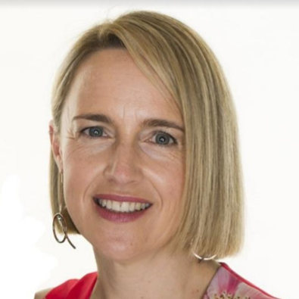
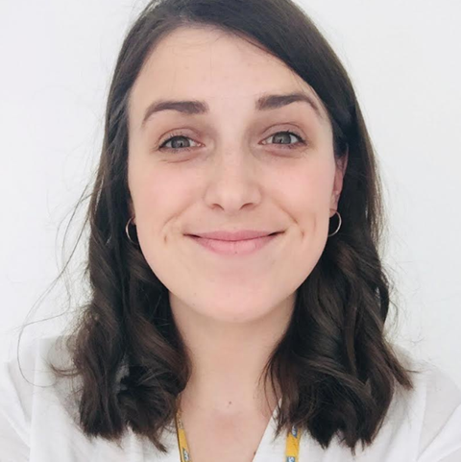
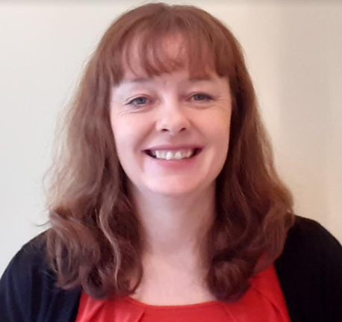
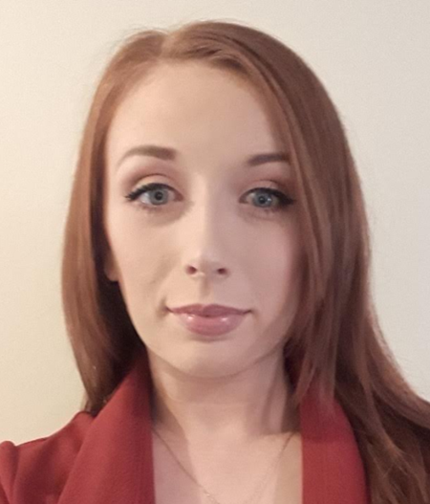
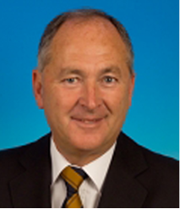
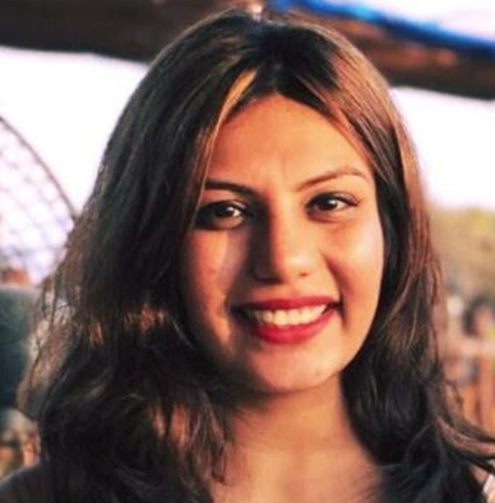
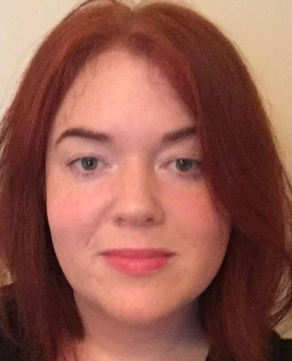
Specialisterne Ireland CLG
Employment Agency No. EA3757, Registered Charity Number: 20200622, Company Reg no.2981268PH
Specialists with a passion for details
“To create meaningful job opportunities for people with autism and similar challenges and to change the way society perceives them.”
Peter Brabazon Noreen Murphy
CEO Operations Manager
Notes:
What we do:
To start I would like to tell you a little about Nick. Nick is a man in his early 30s who is bright, driven, a loyal friend and who has a fantastic sense of humour. Nick is passionate about IT and exceptionally skilled in website development. Nick however struggles with some sensory input, specifically using public transport and wearing office attire. Despite having a level 8 in Computer Science from DIT and incredible self-taught skills, Nick struggled to get a job and was unemployed for 2 and a half years following his degree. Nick’s struggles to gain employment were due to his being on the Autism Spectrum. In years gone by Nick would have remained unemployed, working away on websites at home with no financial or social independence. This would likely have significantly negatively impacted Nicks mental and physical health, independence and financial security. But due to the work of Specialisterne, Nick has now been employed with SAP for close to seven years on a permanent contract, doing what he loves. Nick would struggle with workplace expectations and communication so that is what we supported him with. We worked with his manager to facilitate clothing accommodations, allowing Nick to wear a dark tracksuit rather than typical business attire. We provided ongoing mentoring to Nick, his team and his manager to allow him to get and maintain employment. Nick is now completely financially independent, with his own house and mortgage. He has strong social connections both inside and outside of work and enjoys sharing a few beers with friends in the evenings. Nick now has the confidence to act as a mentor for other individuals on the autism spectrum who are starting out, and advocates for the employment needs of those on the spectrum.
While it is great to hear me speak about Nick, it is better to hear from him himself. Here is a short video.

Slide 3

Who we are
&
What we do

Slide 4
Who we are
Specialisterne Ireland are a disability friendly recruitment consultancy that supports individuals to build skills needed to move closer to employment
Services we offer
- CV and Interview Skills
- Confidence building
- Disability friendly interviews
- Partner company opportunities

Slide 5
Who are our partner companies?
&
What areas can you place people?

Slide 6
Examples of partner companies:
SAP, OpenApp, Northern Trust, Accenture, AIG, DPS Group and many more
Areas:
IT, Finance, Science, Technology, Engineering & Administration

Slide 7
Other Specialisterne Ireland Partnerships:
As well as partnering with companies to support our candidates to move towards meaningful employment opportunities, we also partner with organisations:
AsIAm, Aspire Productions, Galway Autism Partnership, Aspect and Open Doors Initiative.

Slide 8
How can I be placed in one of your partner companies?
Autism friendly or neurodiverse friendly recruitment process
Importance of partnerships in neurodiverse friendly recruitment process
If successful at an autism or neurodiverse friendly interview, Specialisterne Ireland will support the onboarding of the candidate into the workplace
- Available in-employment support

Slide 9
What happens if there isn’t an available role in one of your partner companies?
- If there aren’t suitable positions available in the partner companies, don’t panic.
- We will still support you to find your own work
- What does that mean?

Slide 10
What does ‘Reasonable Accommodation’ Mean?
- A practical change put in place in response to a challenge in the workplace.
- These are implemented when needed.
- Helps a candidate perform to the best of their ability and remain as comfortable as possible in their workplace.

Slide 11
Examples of Reasonable Accommodations
- Clear Communication; e.g. clear direction around workplace etiquette, or expectations around tasks and projects
- Using ear defenders; e.g. in an open plan office or intermittent use, like when the fire alarm is being tested.
- Positioning of workspace in relation to light; i.e. moving desks to be closer or further from natural light

Slide 12
Examples of Reasonable Accommodations (continued)
- Flexibility around lunch hours; As described earlier.
- Ongoing-support in the workplace; Regular feedback on performance and regular check-ins by a manager or mentor
(Ongoing support can be provided by Specialisterne Ireland staff if placed in one of our Partner Companies).

Slide 13
Things to keep in mind;
- Every person is different; challenges vary, and so naturally reasonable accommodations implemented also vary.
- Not every neurodiverse person will require reasonable accommodations in the workplace.
- Research has shown that reasonable accommodations tend to cost little or nothing and are easily implemented.

Slide 14
Covid-19 and Employment
Covid-19 is likely to be with us for some time
Here are some tips for working from home:
Remote Working Tips
Expectations
Setting up your remote working space

Slide 15
Employee expectations in the remote workplace during Covid-19.
What are they?

Slide 16
Thank you!
- If you have any queries about any of the services we offer, you can get in contact with us by;
- Visiting our website: www.specialisterne.ie
- Emailing us: info.ireland@specialisterne.com

Slide 17
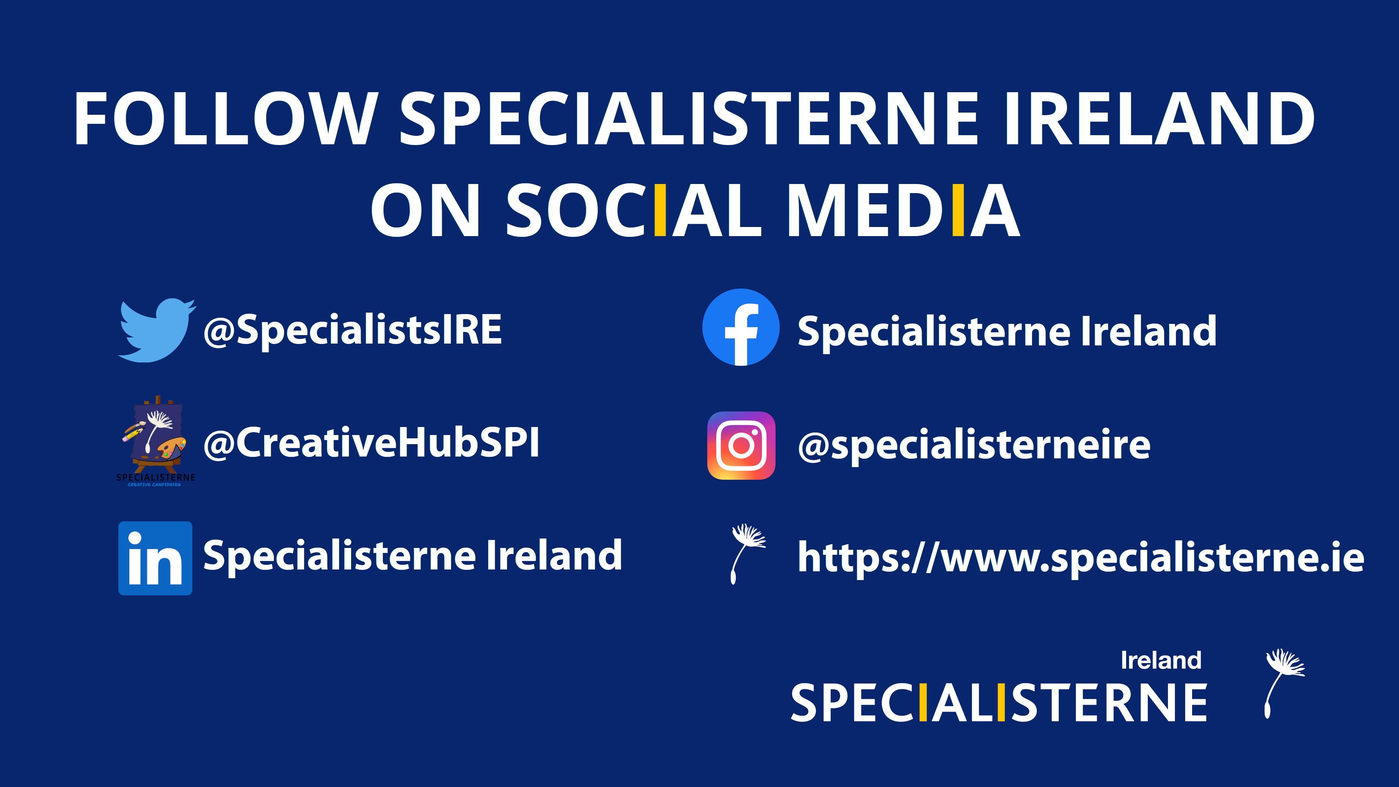

Slide 18

Any questions?

