Slide 1
Get Career Ready!
Career Development Centre
Title: What Jobs are there? Ireland and Abroad
Presenter: Jennifer McConnell

Slide 2
Outline of Session
Advertised jobs
Hidden Jobs Market
Useful Resources

Slide 4
Advertised jobs
GradIreland – the official graduate careers website in Ireland which advertises vacancies on behalf employers.
TU Dublin Jobscene - Our online vacancy platform – register for job alerts

Slide 5
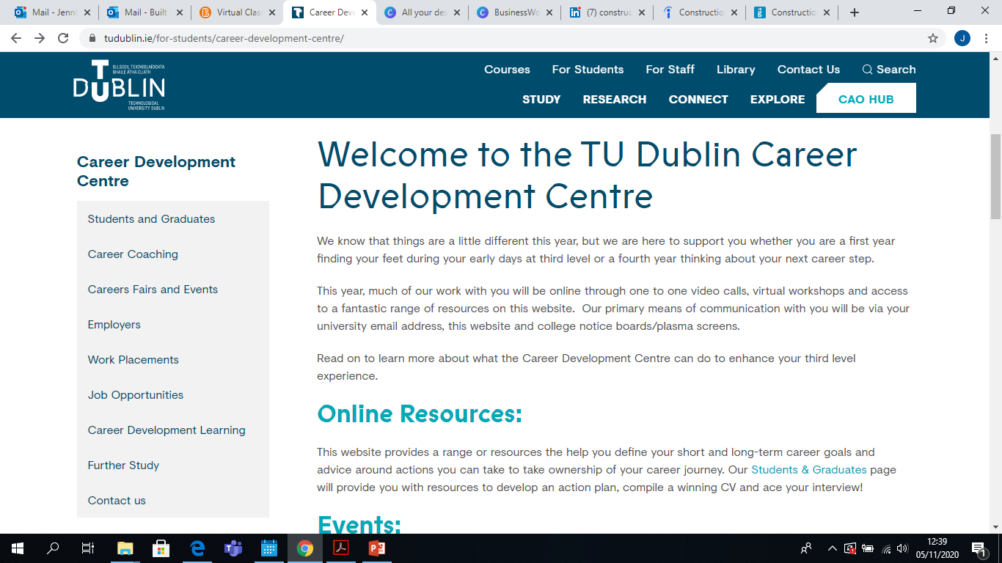
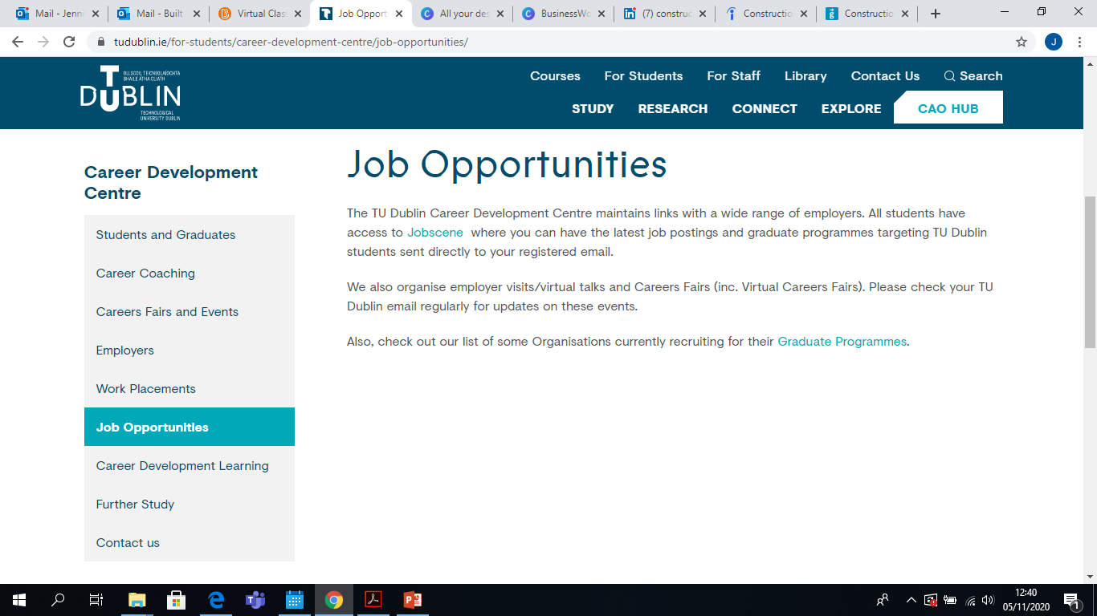

Slide 6
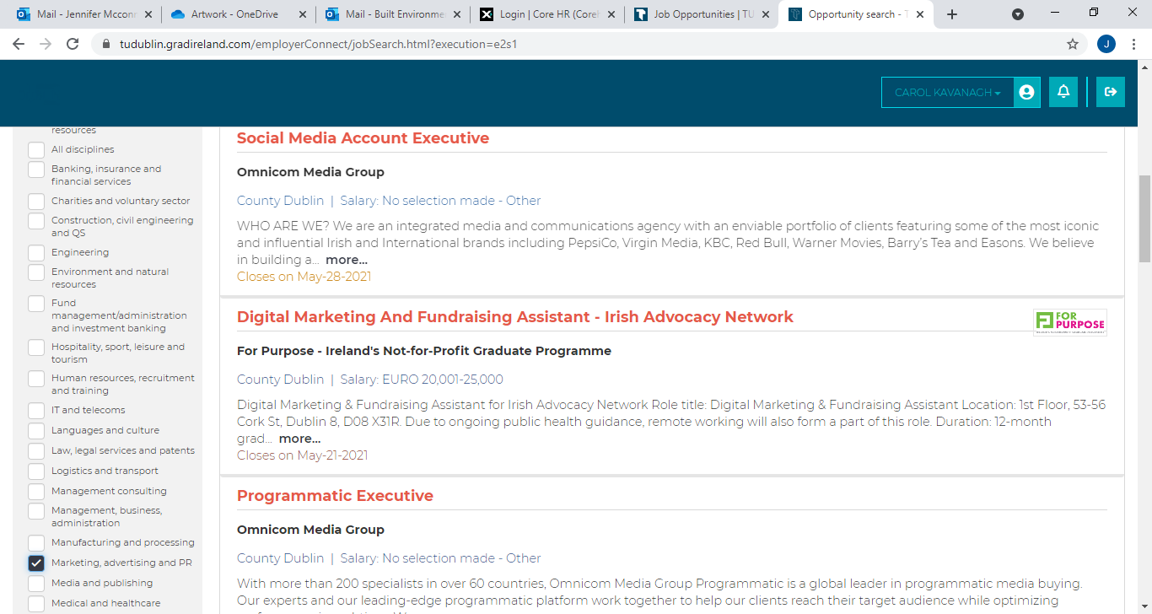

Slide 7
TU Dublin: JOBSCENE 189 Vacancies https://www.tudublin.ie/for-students/career-development-centre/job-opportunities
Accounting& Finance:18
Banking & Insurance: 18
Construction/Quantity Surveying & Engineering: 37
Hospitality: 30
IT and Telecoms: 34
Law:7
Logistics/Supply Chain:5
Management/Business: 23
Marketing: 16
Media and Publishing:11
Medical and Healthcare: 8
Retail, Sales & Customer Services: 7
Science and R&D: 8
Social and Community Work: 19
Teaching and Education:30

Slide 8
General Websites:
www.tudublin.ie/jobscene
www.gradireland.com
www.publicjobs.ie
www.localgovernmentjobs.ie
https://ie.indeed.com/
https://www.linkedin.com/jobs/?originalSubdomain=ie
www.prospects.ac.uk & www.targetjobs.co.uk

Slide 9
Please see the tiny url of Grad opportunities below Grad Ireland.
https://tinyurl.com/grad-employment-opportunities

Slide 10
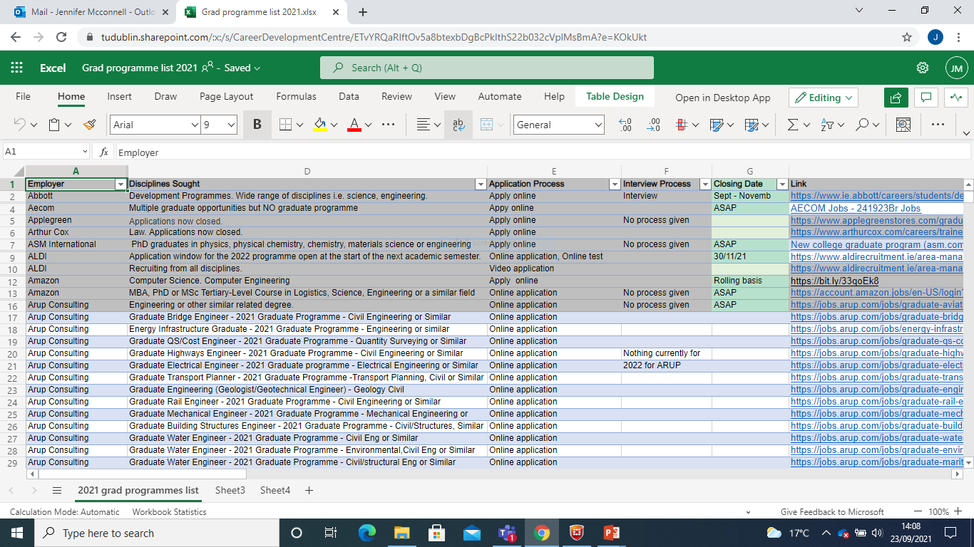

Slide 11
TU Dublin: My Qualification What Next
https://www.tudublin.ie/for-students/career-development-centre/students-and-graduates/my-qualifications---what-next/

Slide 12
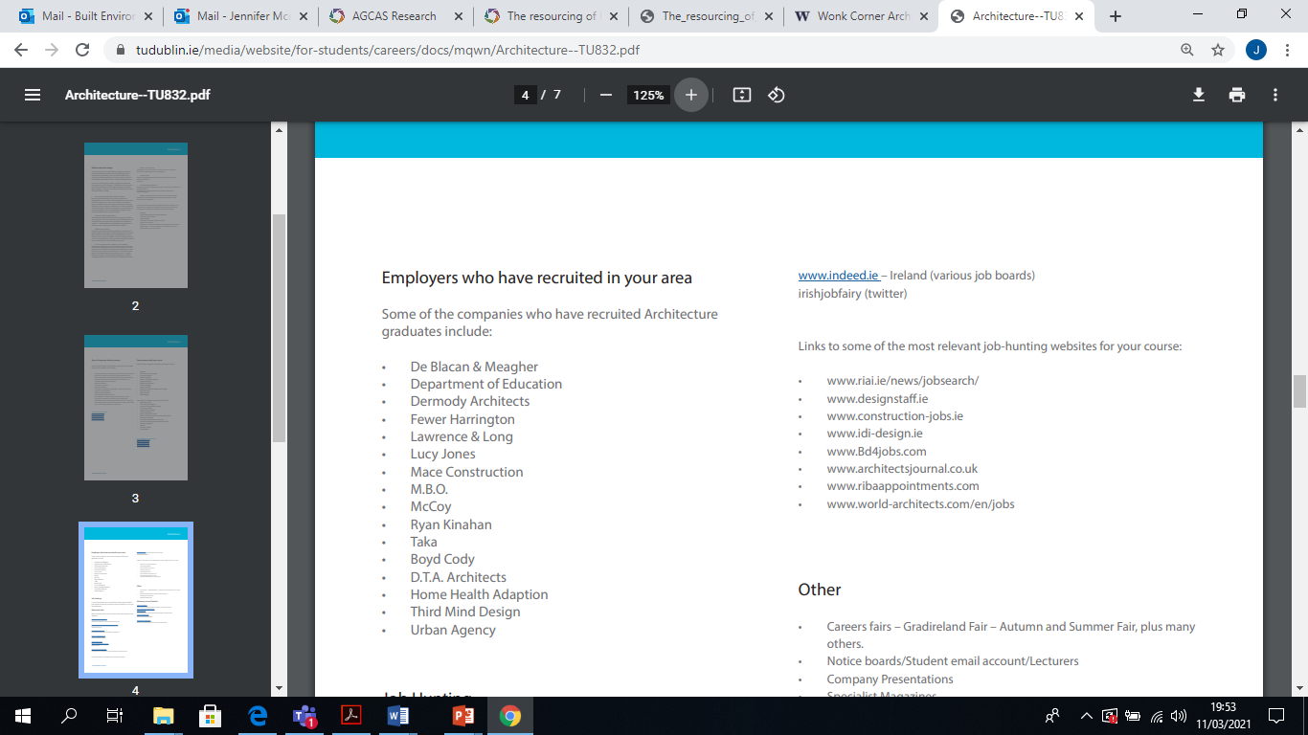

Slide 13
Advertised Jobs – University Resources
Career Development Centre – www.tudublin.ie/careers
Jobscene: internships/summer internships (worldwide), insight days, grad jobs Email alerts
Events Calendar: www.tudublin.ie/for-students/career-development-centre/careers-fairs-and-events
Class Emails
Handouts: Job Hunting section - www.tudublin.ie/careers
My Qualification what next? -https://www.tudublin.ie/for-students/career-development-centre/students-and-graduates/my-qualifications---what-next/
Career Workshops
University Career Services – www.gradireland.com – Email alerts, virtual events,
Grad stories. Gradireland Directory - https://lnkd.in/ewe4ntF
Other Graduate Career Websites – ww.nextstepsupport.org www.careersportal.ie – jobs section, virtual events

Slide 14
Advertised Jobs
Job websites – e.g., indeed.ie – Ireland (various job boards), mondotimes.com - worldwide, monster.ie, irishjobfairy (twitter), irishjobs.ie, jobsireland.ie, glassdoor.ie, simplyhired.ie, taleo.net, etc.
Google Search – Search ‘Summer Internships’ – area of interest/location
Company websites/Linkedin pages – advertised vacancies, internships, summer internships, ‘insight days/programmes’, virtual events
Recruitment Agencies: recruitmentagenciesireland.com, irishjobs.ie/agencies– list of recruitment agencies
Careers fairs/Company webinars– TU Dublin Careers Fairs, Gradireland - Autumn and Summer Fairs (Career Discovery event – June), International Careers Fair, Languages Fair, plus many others. Company presentations and talks.
www.tudublin.ie/for-students/career-development-centre/careers-fairs-and-events

Slide 15
Advertised jobs
Emails from your career coach
LinkedIn
Employer websites
Professional bodies
Other career services websites
See full list of useful websites here:
https://www.tudublin.ie/media/website/for-students/careers/docs/Advertised-Vacancies.pdf

Slide 16
Advertised Jobs – Sector Specific
Financial/Banking Careers: efinancialcareers.ie (student section), jobs.ie (Financial Services Jobs, Accountancy and Finance Jobs, etc.), financejobs.ie, thevault.com, the panel.com & many recruitment sites
https://jobs.accaglobal.com/jobs/ireland/?Keywords=graduate
https://www.charteredaccountants.ie/Prospective-Students/Vacancies/Milkround
https://www.cpaireland.ie/JobSearch
Finance booklet, graduate programmes –gradireland.com, Linked-in – accounting, banking, finance opportunities

Slide 17
Advertised Jobs – Sector Specific
HR – hrcrossing.com, ie.linkedin.com/jobs/human-resources-jobs, numerous recruitment sites
Supply Chain Management - ipics.ie, NITL- national institute for transport and logistics
Marketing/PR : Marketing communication service www.wpp.com – (advertising, public affairs, PR, marketing worldwide), digitalmarketingjobs.ie, mondotimes (worldwide)
Voluntary sector/Charities/NGOs: activelink.ie, volunteeringireland.com, dochas.ie – association of non-governmental development organisations, volunteering opps: comhlamh.org, publicaffairsireland.com, impactpool.org, nssb.ie, charitycareersrecruitment.ie
http://www.wheel.ie/directory/ (directory of voluntary and community) organisations

Slide 18
Advertised Jobs – Sector Specific
Public sector jobs: local and national press, publicjobs.ie, localgovernmentjobs.ie,www.publicjobs.ie/publicjobs/publication/document/careerinfo.pdf
Teaching jobs: educationcareers.ie, educationposts.ie, research opps: euraxess.ie, heanet.ie, jobs.ac.uk, VEC: ivea.ie, eduation.ie, (English Language Assistant scheme – 5 countries (Austria, France, Germany, Italy, Spain), University and College websites
Publications: in your area of interest

Slide 19
Sector Specific
Enterprise/Own Business:
Incubation centre TU Dublin (start ups) http://www.tudublin.ie/hothouse/, http://www.dit.ie/careers/studentsgraduates/interestedinselfemployment/
Start up websites:
Start-up companies – www.startupdublin.com, dublinstartupjobs.com
FDI and indigenous – www.makeitinireland.com, www.itshappeninghere.ie
https://angel.co/ - start up jobs worldwide

Slide 20
Worksheet
Fill in your top 3 best ways to find Advertised Vacancies

Slide 21
Hidden Jobs Market

Slide 22
Unadvertised jobs
It is estimated that only about a quarter of jobs ever get advertised (Linkedin:2016)
Word of mouth
Employee referrals
Direct contact
Current Employee

Slide 23
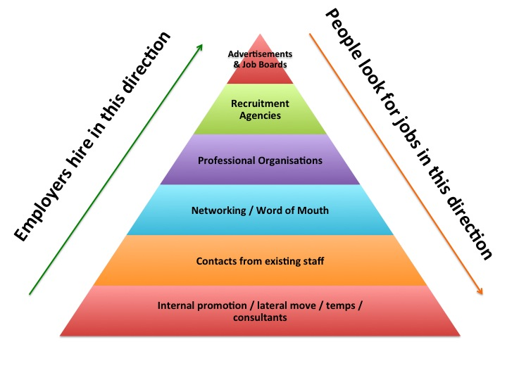

Slide 24
Hidden Jobs Market
Who is in my network? – friends, family, neighbours, sports clubs, classmates, lecturers, etc
Informational Interviewing/Shadowing
Social networking sites (twitter, LinkedIn, Facebook, Blogs, Discussion Groups)
Linked-In (set up a profile, link to others, search/follow companies - employees who have Linked-in profiles, advertised jobs, groups).
*LinkedIn: Jobs for Students and Recent Graduates -www.linkedin.com/studentjobs
www.linkedin.com/internships
twitter:list-employers-posting-jobs-twitter. Google alerts: google.com/alerts
First Destination Reports TU Dublin Alumni – TU Dublin Linked-in

Slide 25
Hidden Jobs Market
Speculative applications + cold calling - Use directories – e.g. Kompass.com, Marketing Services Directory, Public Affairs Directory, Financial Services Ireland (fsi.ie), etc.
Check out industry award recipients – Best Workplaces in Ireland, e.g. Ireland’s top 1000 companies http://www.top1000.ie/companies
Labour Market trends - www.careersportal.ie, IDA (Industrial sectors), www.tudublin.ie/careers (labour market news), https://www.siliconrepublic.com/careers
College - projects, thesis, placement, guest speakers, societies/clubs –events, committees.
Volunteering - https://www.volunteer.ie/volunteers/find-a-volunteer-role/
Events - Employer and networking events, conferences, short courses, tradeshows

Slide 27
Unadvertised jobs
Tell everyone you’re looking for work (relatives, friends, neighbours)
Use any contacts you have in the industry
Use LinkedIn
Talk to your lecturers
Target companies you are interested in and make contact directly with them
Practice “cold calling” with a friend or relative (or your career coach)

Slide 28
Networking
YOU
Family
Friends
Local Community
Linkedin: Alumni Companies (follow) Connect with Staff Join Specific Groups
Job Page
International Community
Part-Time Work Clubs & Societies
Sports Clubs Volunteering Arts/Music/Religion
University: Classmates Academic Staff Guest Speaker
Alumni
Placement : Good Terms. Keep in Touch
Work (Job) Shadow
Mentor

Slide 29
Use creative approaches: Networking
Make use of existing contacts (family/friends/teammates/societies/your community)
Attend events, conferences, short courses & trade shows
DIT Alumni
Talk to people in industry - Informational Interviewing
Get in touch with guest speakers
Find a mentor
Job shadowing
Volunteering
Use social networking sites
Notes:
Spend more of your time on the unadvertised positions …………… Hidden job market
At the moment – SME’s are cutting down on newspaper advertising and agencies
**Consider alternative roles (marketing, sales, customer service, retail)**

Slide 30
Worksheet: Network Brainstorm
List who in your Family Network could be useful in your Job Search
List one friend who could be helpful in your Jobsearch
List one Classmate who could be helpful in your JobSearch
List one Academic who could be helpful in your Jobsearch
List one company or Alumni contact on Linkedin who YOU DO NOT KNOW who could be helpful in your Jobsearch.

Slide 31
Speculative applications
Target companies
-Research company on Website and Linkedin: Look up Employees and Dept. Connect
Create Targeted and Tailored CV and Cover Letter.
-Find name to send Cover Letter to
-Highlight how your Education/Skills/Work Experience MATCH the Company
-Look up what Employees list as Duties on Linkedin/ Use generic Job Description to guide (Gradireland/Prospects.ac.uk)
Pick up the phone!
Contact organisation with ideas (ways to reduce costs, make them more money, speed up R+D. Explain how you can help them i.e. your unique selling points)

Slide 32
Unadvertised jobs
To get a list of companies (Ireland and abroad) that are relevant to your chosen field these websites are useful:
https://www.idaireland.com/
https://www.enterprise-ireland.com/en/Source-a-Product-or-Service-from-Ireland/Sector-and-Company-Directories/
https://ie.kompass.com/

Slide 33
Useful Resources - Some Professional Bodies/Associations (Members, training, events, opportunities, news, CV Posting)
www.mii.ie – Marketing Institute of Ireland
www.cipd.ie –HR and People Development
www.cilt.ie – Institute of Logistics and Transport
www.charteredaccountants.ie – Chartered Accountants Ireland, www.cpaireland.ie – Certified Public Accountants Ireland, www.cimaglobal.com – Chartered Institute of Management Accountants, www.accaglobal.com – Association of Chartered Certified Accountants
www.iii.ie – Insurance Institute, www.taxinstitute.ie – Irish Tax Institute, www.imi.ie – Irish Management Institute, www.ipa.ie – Institute of Public Administration
Business and Other Associations, e.g.: www.irishexporters.ie, www.ibec.ie (Irish Business and Employers Association), Financial Services Ireland, etc.
Linkedin Discussion Groups and Online Forums
My Qualification what next? – Professional Bodies/Association related to each discipline

Slide 34
MILLIONS OF CAREER PATHS
OVER 9 MILLION
COMPANIES
YOUR ONLINE
CV
500 million members – lots of contacts
EMPLOYERS SEARCHING FOR CANDIDATES

Slide 35
DIT past graduates/Alumni
www.linkedin.com
Technological University Dublin – school
Drop down left to Alumni
Search by Key word e.g Construction Management
Filter search results by what people do/ where they work/ what they studied etc.
Useful to check dates attended too to see more recent employers
You can also search from the main text box on home page and use filters
Notes:
64,000+ DIT alumni on LinkedIn– see where they work, location, role, skills, what they’ve stuided.

Slide 36
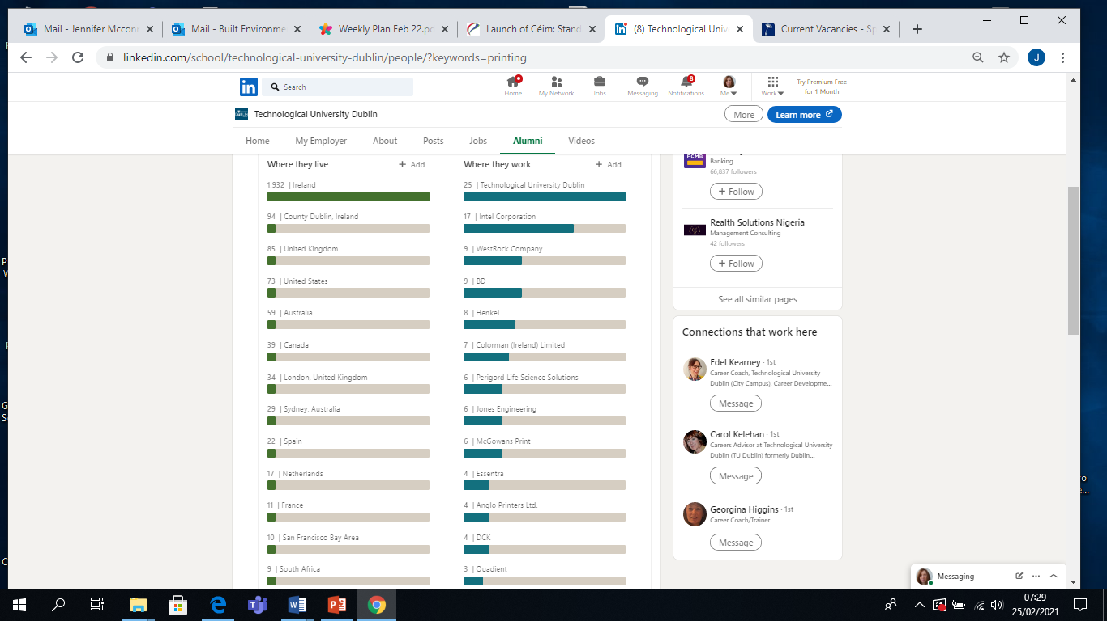

Slide 37
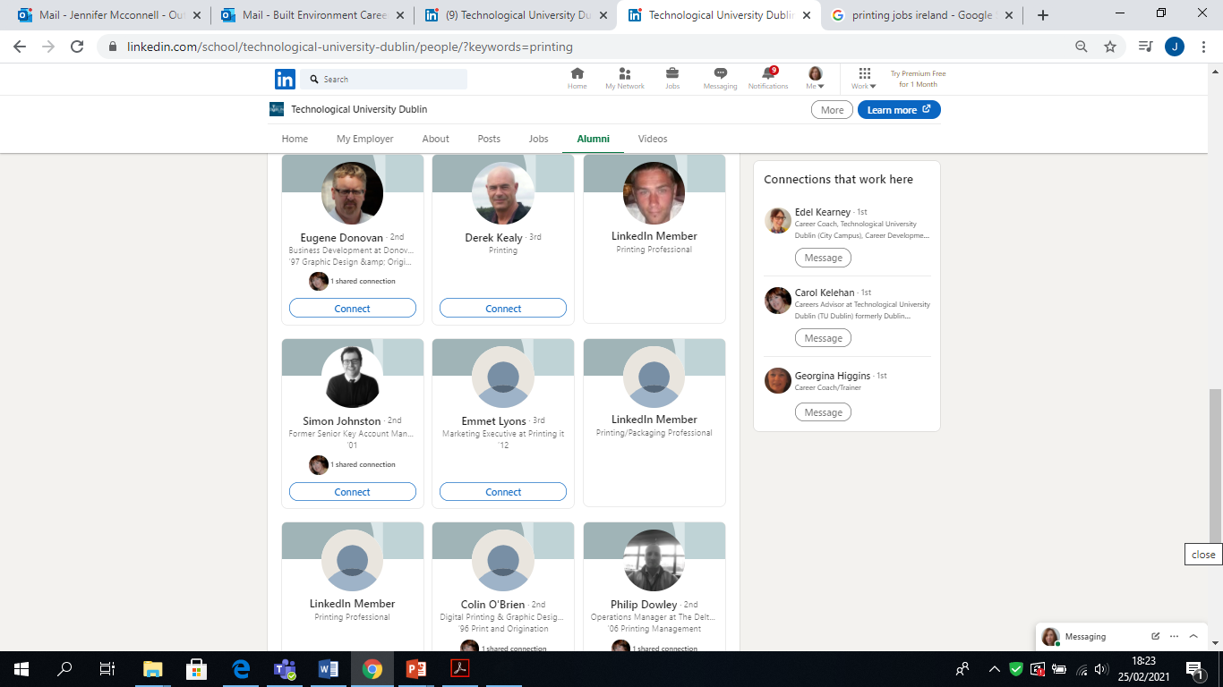

Slide 38
Informal communities formed around industries, professions, themes, niche topics, etc.
Excellent sources of information and discussion forums
Group members get 4x the number of profile views
Group members can connect with one another
easier than if not connected – and easier for recruiters to contact you
Group members can send each other "private" messages without being connected on LinkedIn
Raise your profile by sharing useful articles and liking and commenting on other people’s posts on the group page
LINKEDIN GROUPS
.
.
Notes:
LinkedIn Groups provide a place for professionals in the same industry or with similar interests to share content, find answers, post and view jobs, make business contacts, and establish themselves as industry experts.
Over 2 million groups on Linkedin
2. You can join up to 50 groups at one time, so when you’re job hunting, join as many as you can - (you can leave a group at any time, so there's no harm in experimenting /trying some out)
3. Being in a group provides a private space to interact with others who share your interests.
5. You can get great resources on things going on in your area, and use it as a support to get advice on latest projects or thesis from experts.
6. Finally on groups, because of the nature of Linkedin, if someone is difficult to connect with, by joining one of the groups that person is in, you make the connection closer, and therefore easier to connect.
Finding and joining groups is easy. From your LinkedIn Home page, follow these steps:
Go to the search bar at the top of the page.
Type in your subject -- for example, IT Security.
Click on the Groups about IT Security result, and you will see there are 14,800+ groups for that subject.

Slide 40
Job hunting abroad

Slide 41
Job hunting abroad
Grad programmes
Multinational companies
Work abroad programmes (e.g. J1)
European Institutions
International temping agencies
Check out country guides:
https://targetjobs.co.uk/careers-advice/working-abroad

Slide 42
Job hunting abroad
Country Resources:
Australia, Canada, China, New Zealand, USA
https://www.tudublin.ie/for-students/career-development-centre/students-and-graduates/resources/
Country Profiles: Work Abroad Series (A-Z)
https://www.prospects.ac.uk/jobs-and-work-experience/working-abroad

Slide 43
Overseas Opportunities
Opportunities abroad- www.prospects.ac.uk – working in UK and abroad, savethestudent.org, targetjobs.co.uk, ww.nextstepsupport.org ww.kent.ac.uk/careers/sitesint.htm - www.rileyguide.com – working in different countries www.ec.europa.eu – Jobs in Europe, www.iaeste.org – work experience abroad
Working abroad handouts - www.tudublin.ie/careers
Internship websites - eurobrussels.com, enternships.com, iagora.com, www.spain-internships.com, www.mountbatten.org, Harold Burson Summer Internship Programme: www.burson-marsteller.com Washington Ireland Programme http://wiprogram.org

Slide 44
Advertised Jobs – EU
EU Jobs - https://ec.europa.eu/eures/
http://www.careersportal.ie/sectors– Irish voices/EU Jobs/Working in the EU
European Movement Ireland internships - europeanmovement.ie, www.eu-careers.eu, eurograduate.com, www.epso.eu, eujobs.ie, europe.jobs.com, eurojobs.com
European Parliament Traineeships: http://www.europarl.europa.eu/parliament/public/
Council of the European Union traineeships: http://www.consilium.europa.eu/
Commission traineeship: http://ec.europa.eu/stages/index_en.htm

Slide 45
Remote Opportunities
Remote Job Websites
www.remotejobsireland.com
https://www.jobs.ie/remote-jobs
https://remote.co/remote-jobs/
60 best remote job websites - https://www.ryrob.com/remote-jobs-websites/ -
https://www.creativelive.com/blog/best-sites-finding-remote-jobs/
https://www.linkedin.com/jobs/work-at-home-jobs

Slide 46
So what can you do right now? A lot!
By focusing on these key areas right now, you can get ahead and make the most of job hunting
Networking
Research roles and the industry
Spend time developing your personal brand
Develop new skills/address skills gaps
Make speculative applications

Slide 47
Finally…..
Start early!
Develop a winning CV & Cover letter
Check out CV resources on our website here: https://www.tudublin.ie/for-students/career-development-centre/students-and-graduates/cvs-letters-applications/
Watch out for CV review clinics
Watch out for CV and cover letter workshops
Watch out for Linkedin Workshops

